Slide 1
Detection of
Frequency Signature of Geographical Land Features by using MODIS LST Data
Part III
Preprocessing
Seyed Abolfazl Masoodian
University of Isfahan
Isfahan, Iran

Slide 2
Basic Matrices

Slide 3
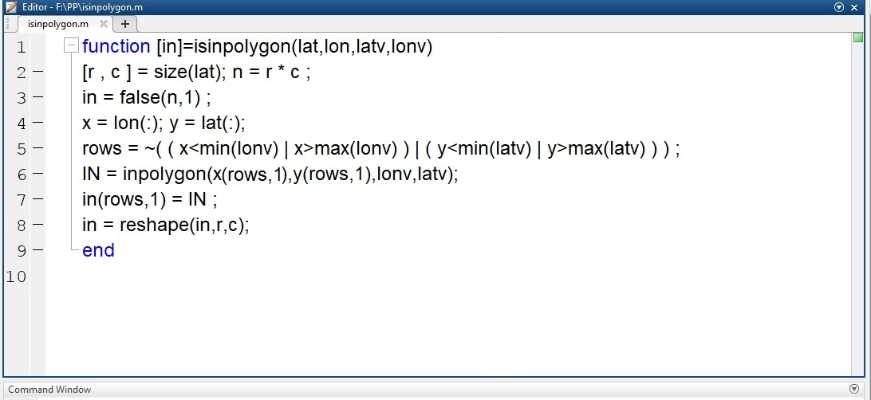

Slide 4
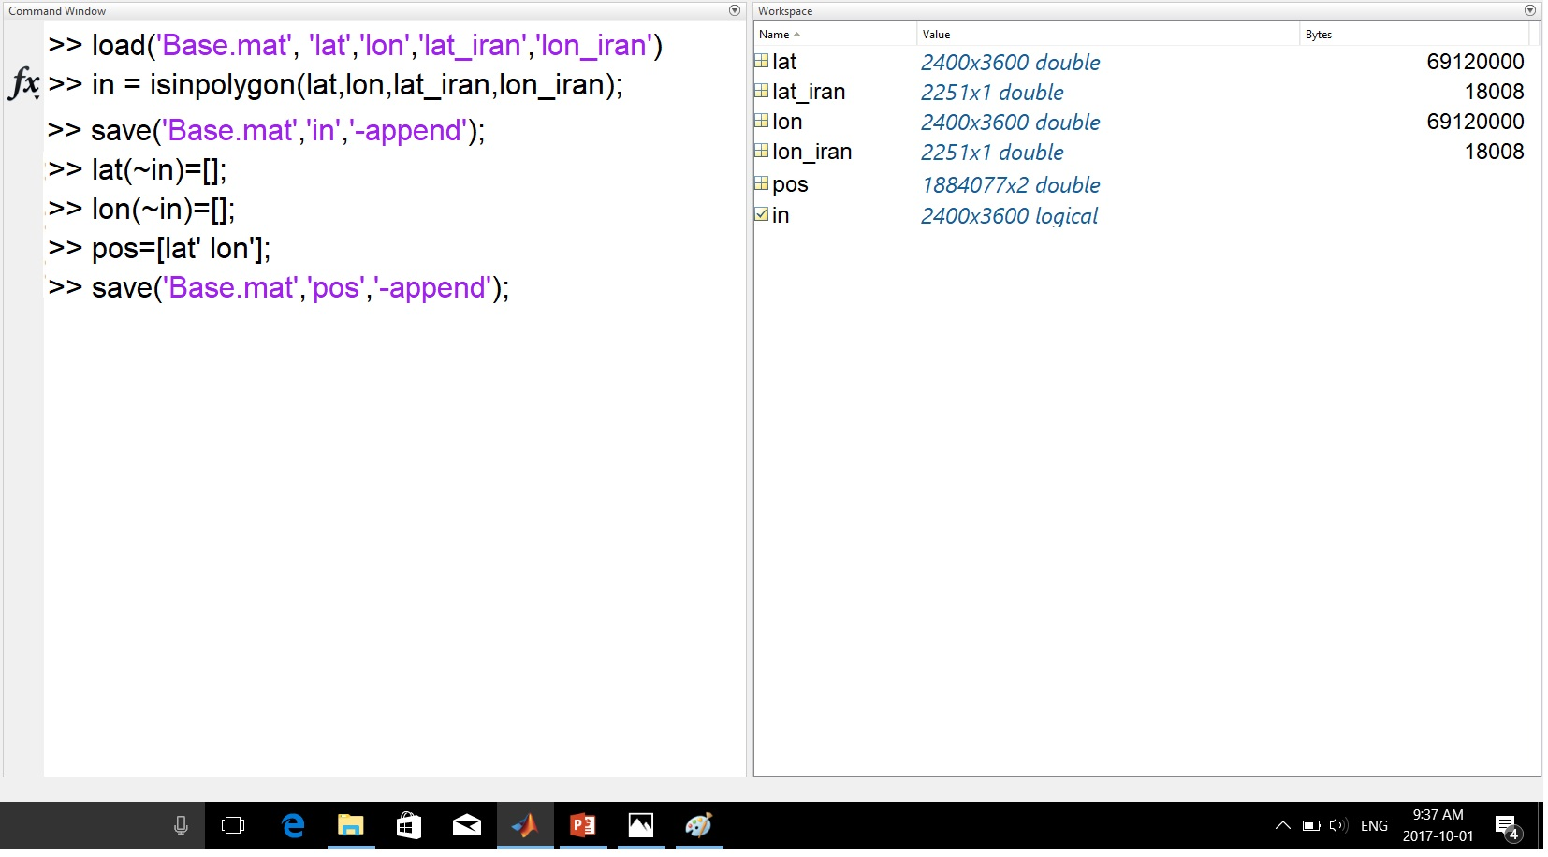

Slide 5
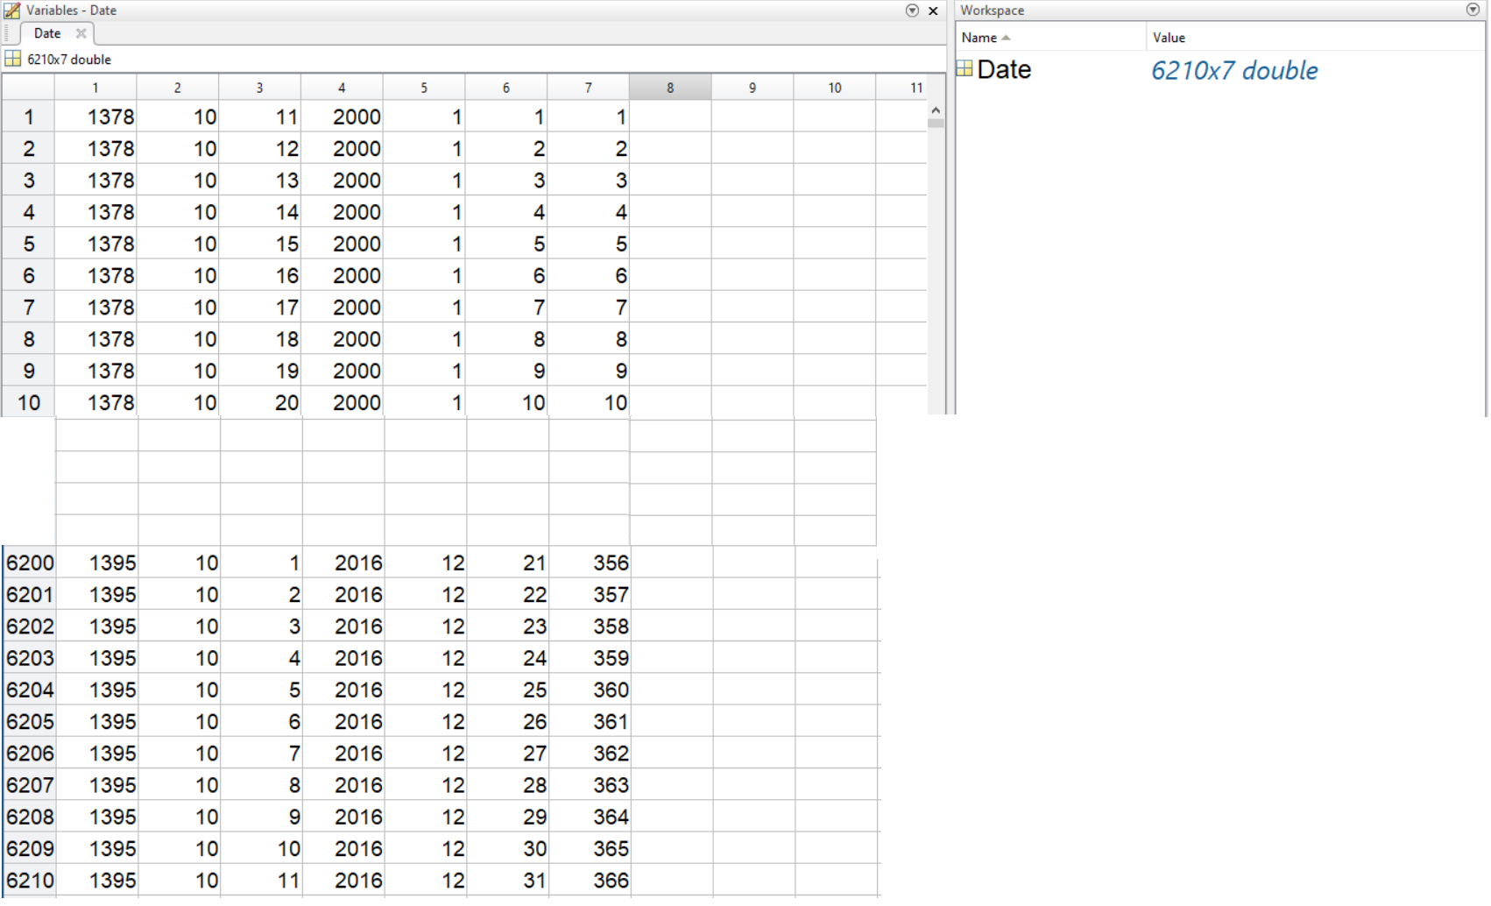
Date Matrix

Slide 6
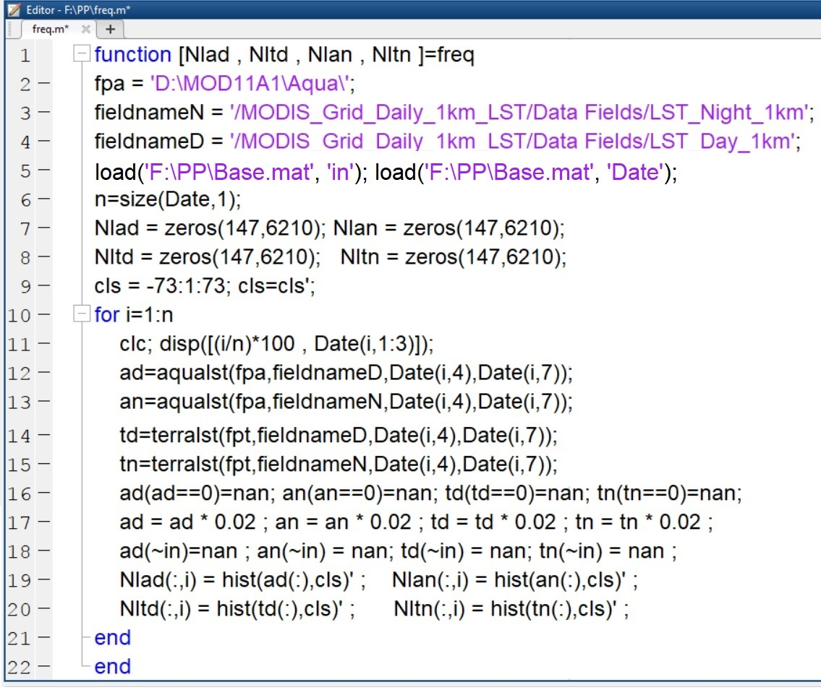

Slide 7
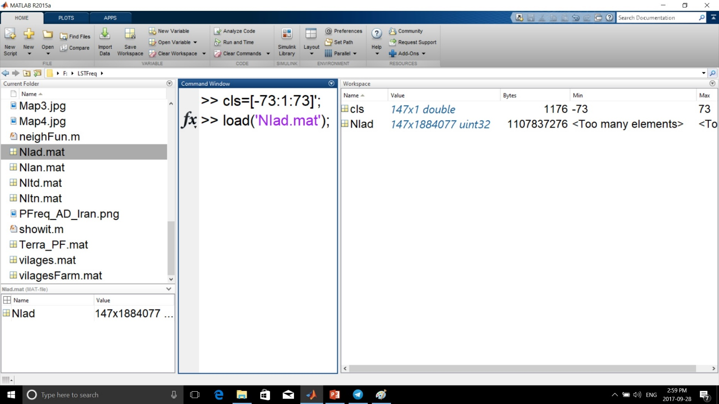
Aqua Day\LST Frequency Distribution

Slide 8
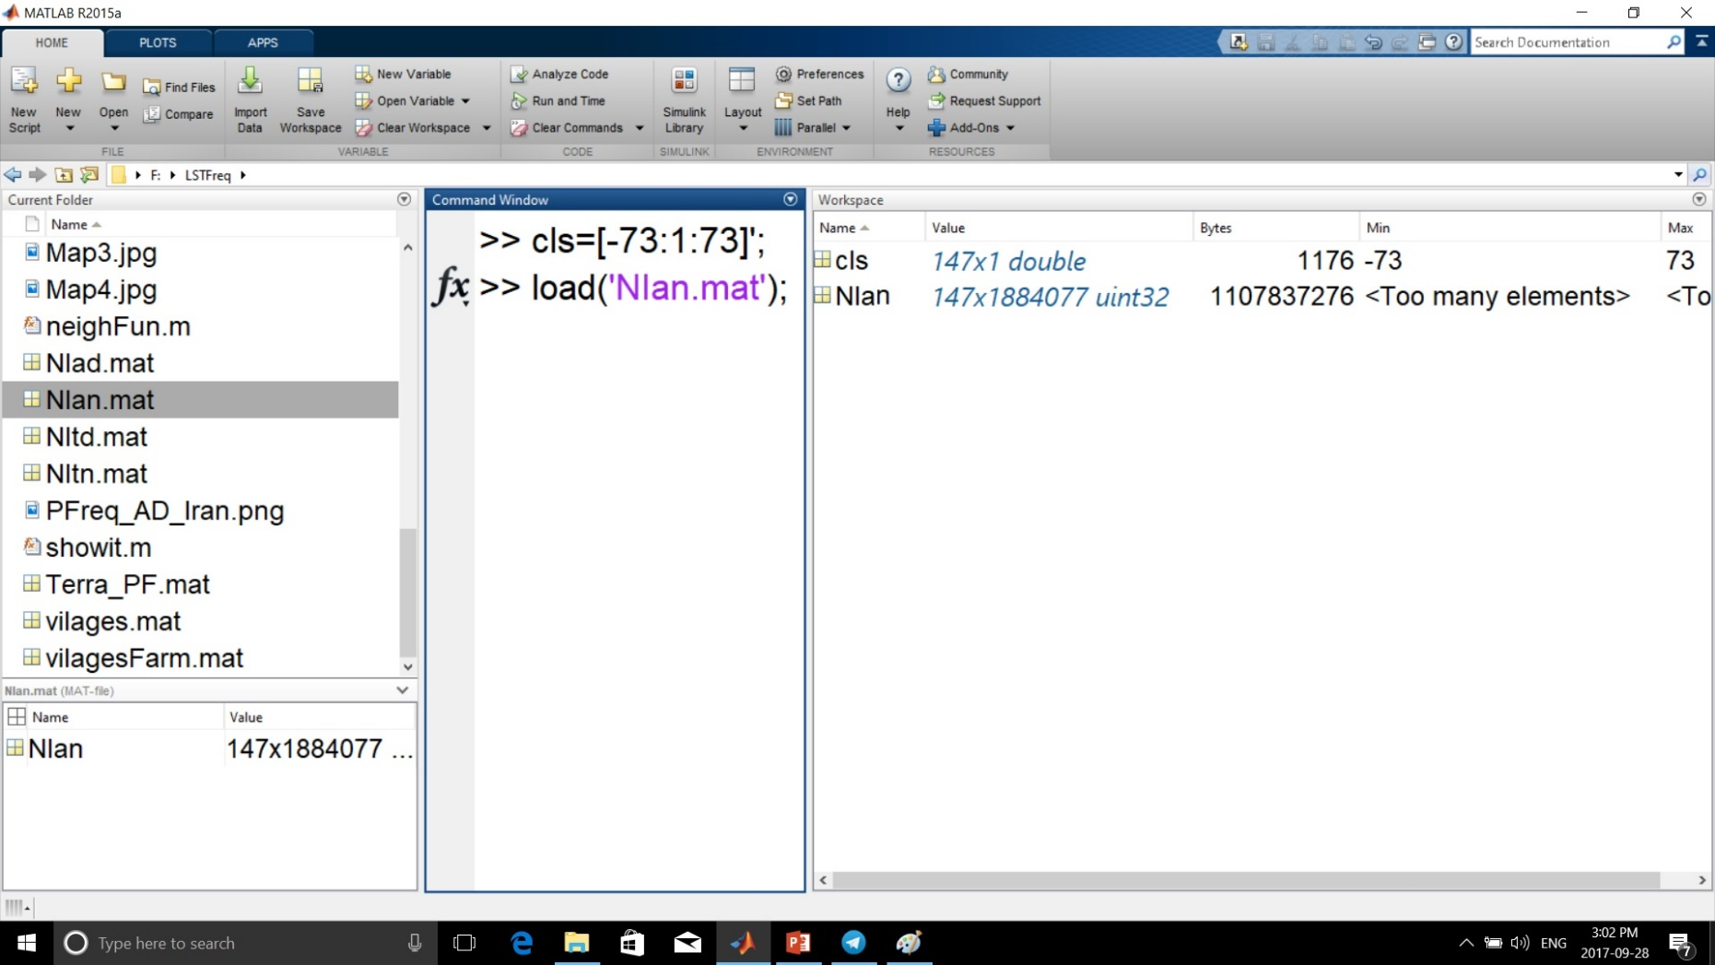
Aqua Day\LST Frequency Distribution

Slide 9
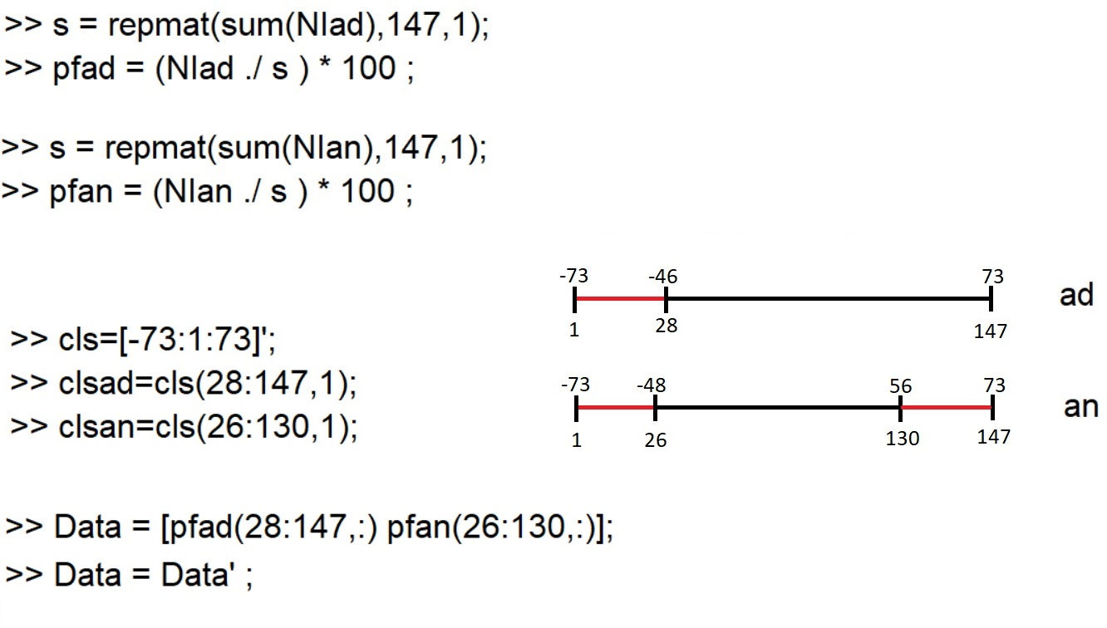
Frequency to Percentage Frequency

Slide 10
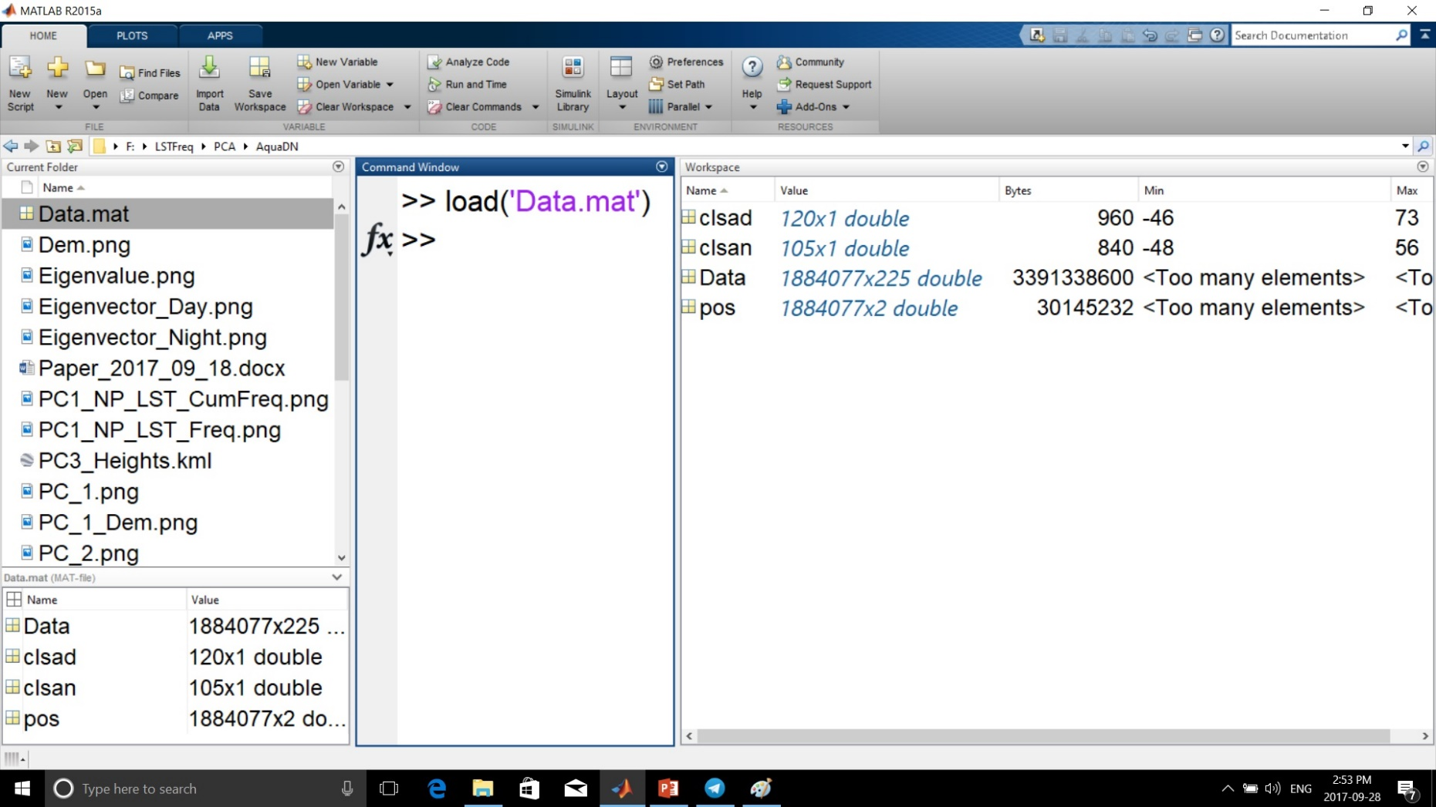
Percentage Frequency of LST:

Slide 11
PCA

Slide 12
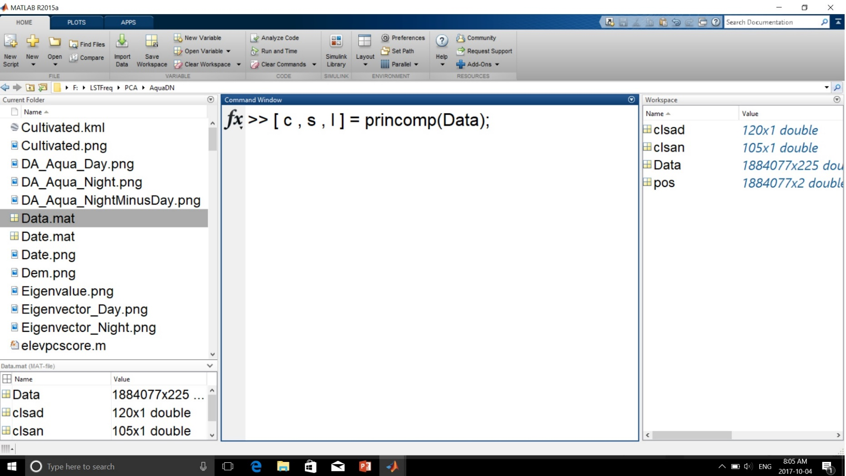
PCA on Percentage Frequency of LST:

Slide 13
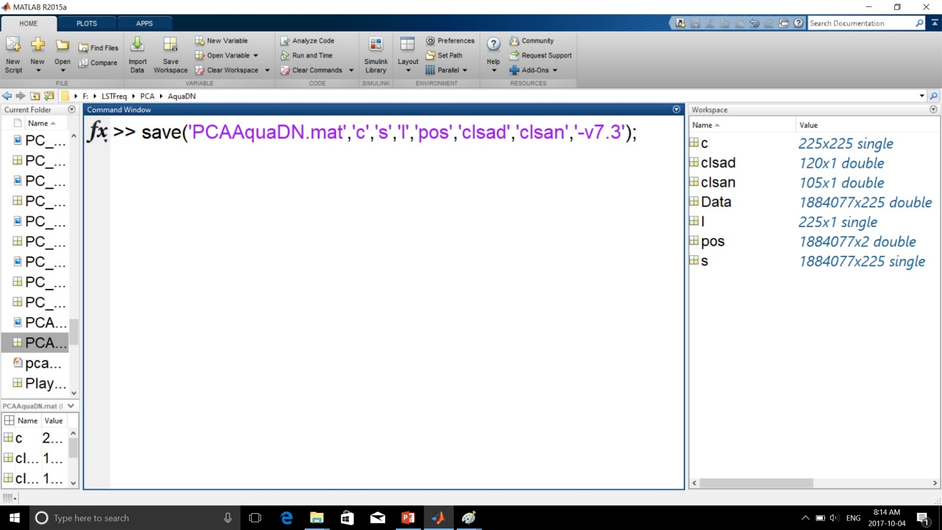
PCA on Percentage Frequency of LST:

Slide 14
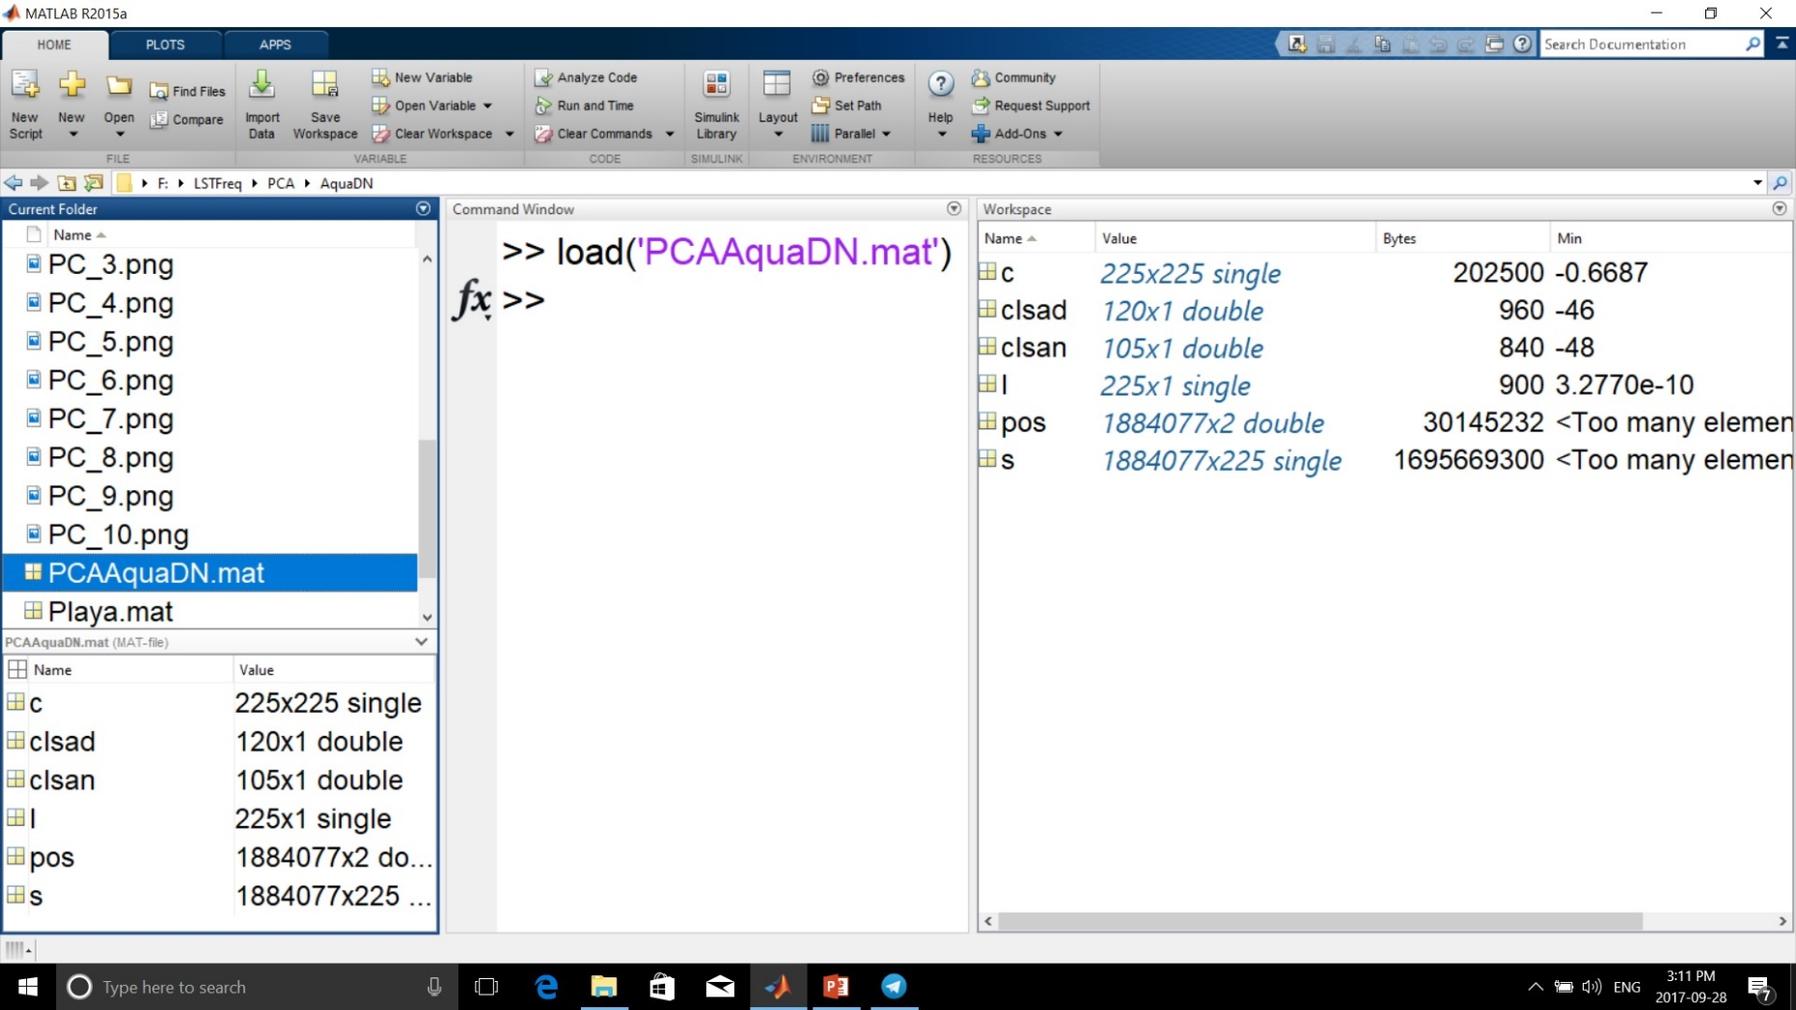
Aqua\LST\Day and Night: PCA outputs

Slide 15
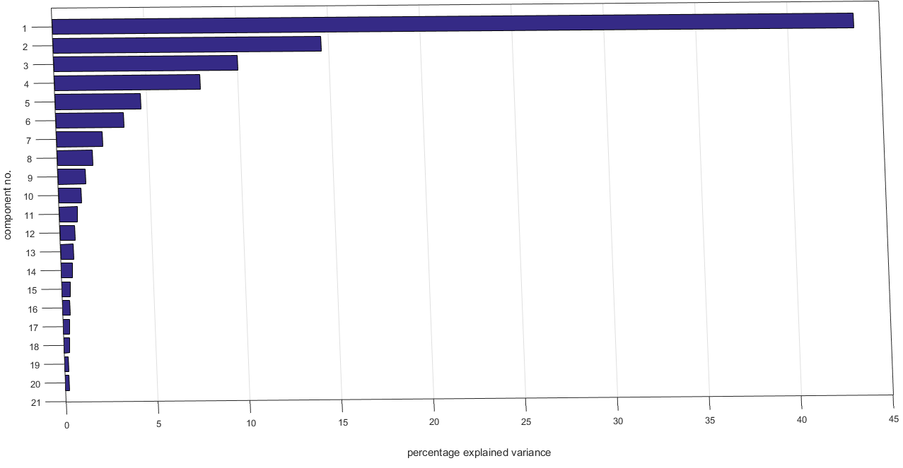
PCA Eigen values

Slide 16
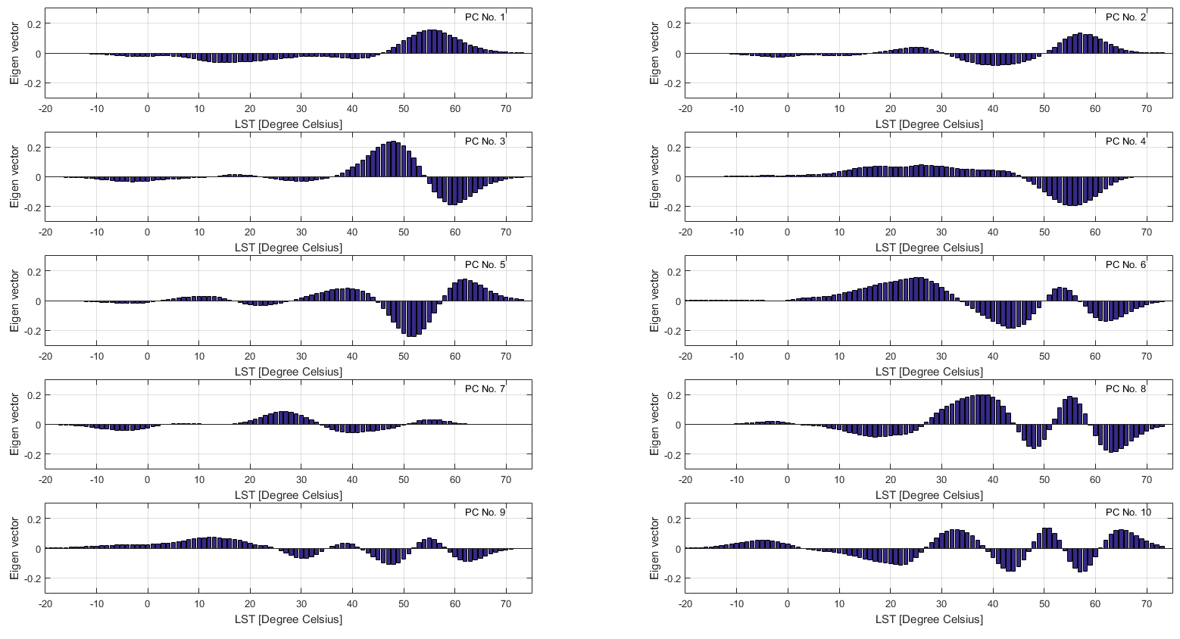
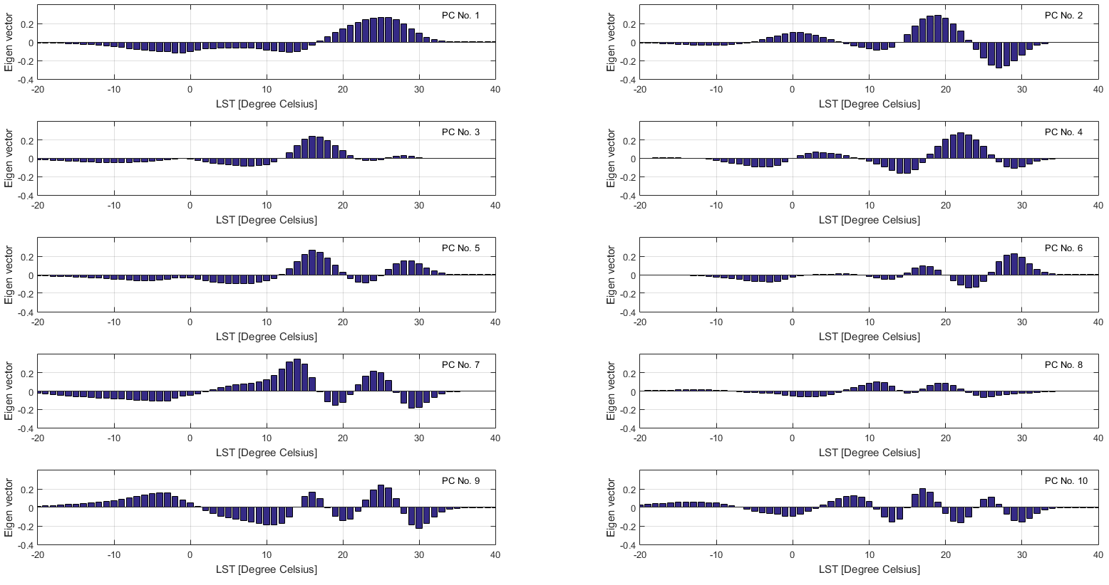
PCA Eigen vectors
Day
Night

Slide 17
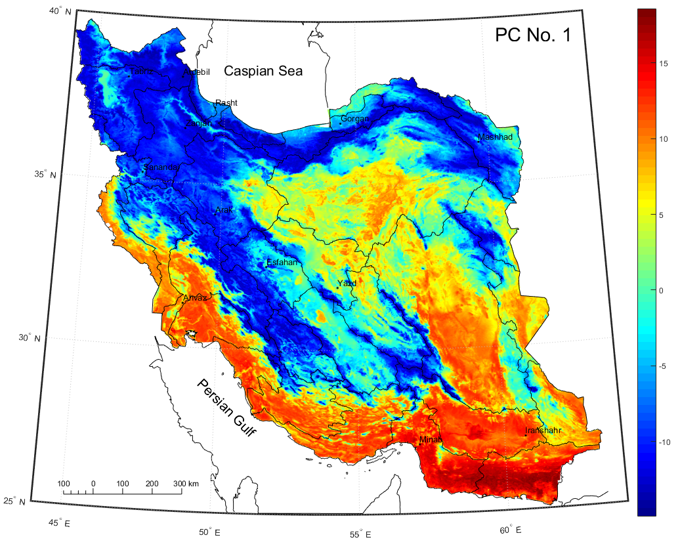
Climatic Component

Slide 18
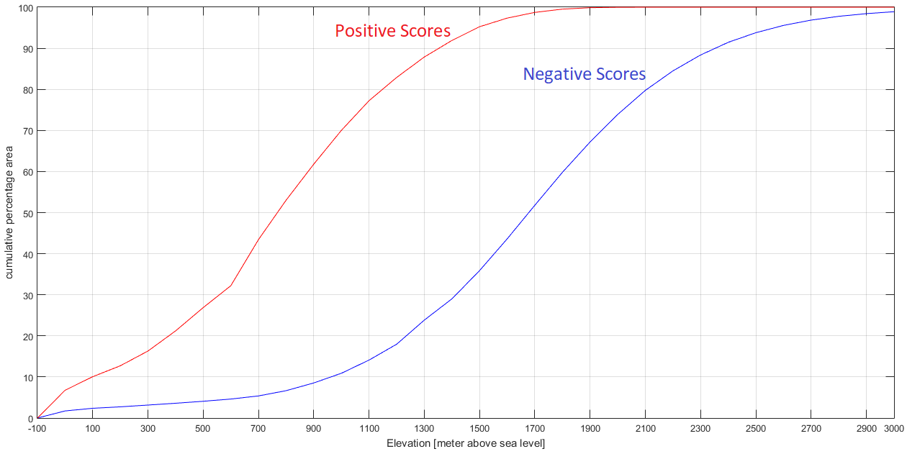

Slide 19
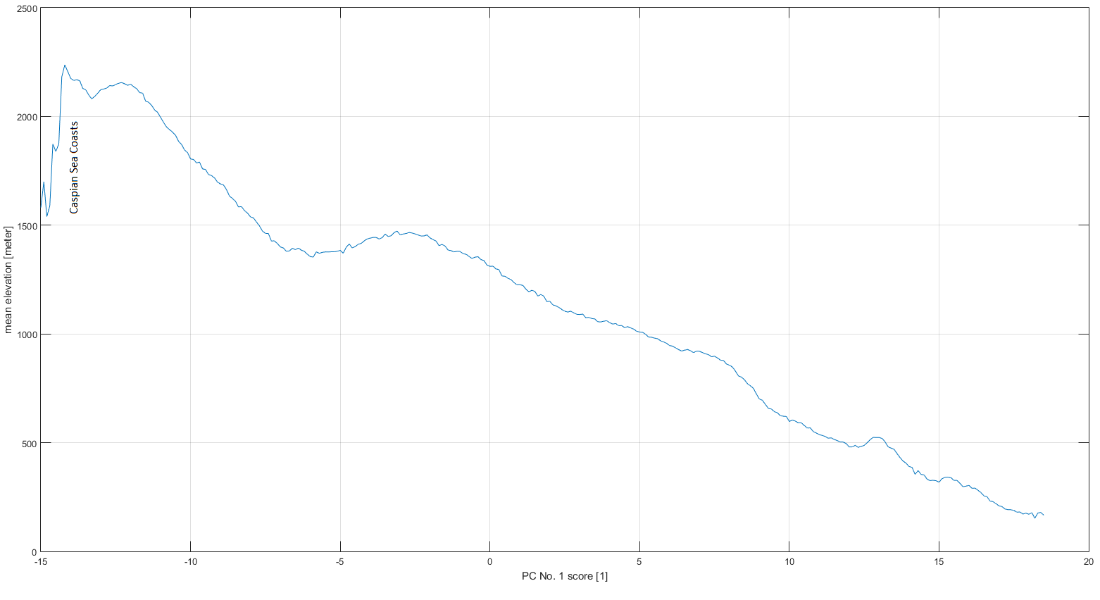
Caspian Sea Coasts Vs Persian Gulf Coasts

Slide 20
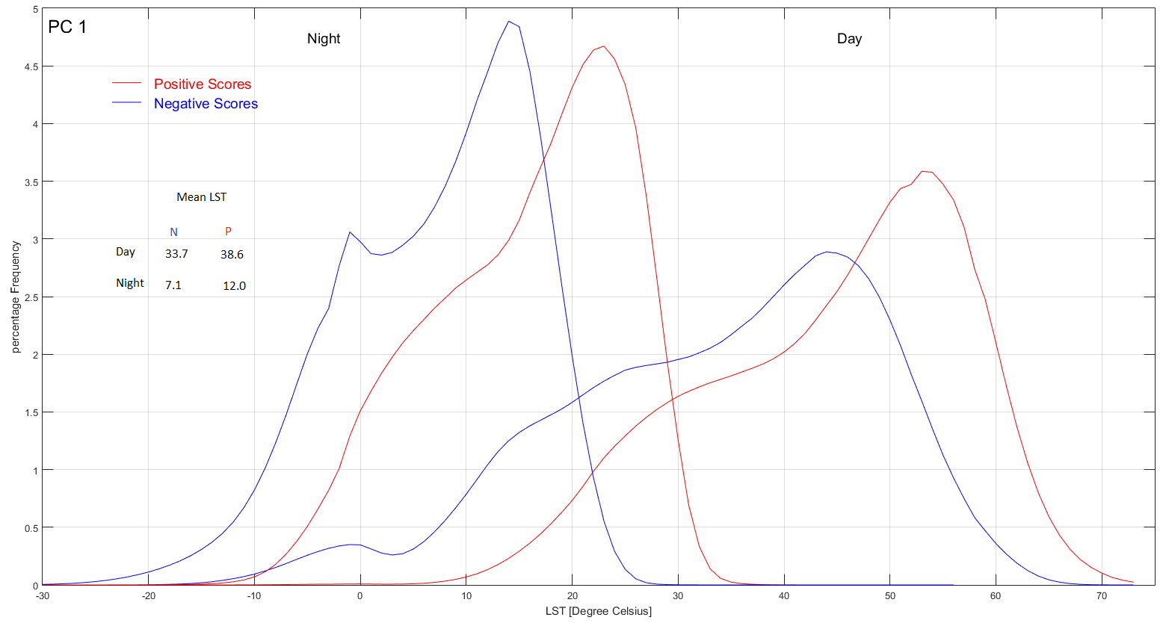
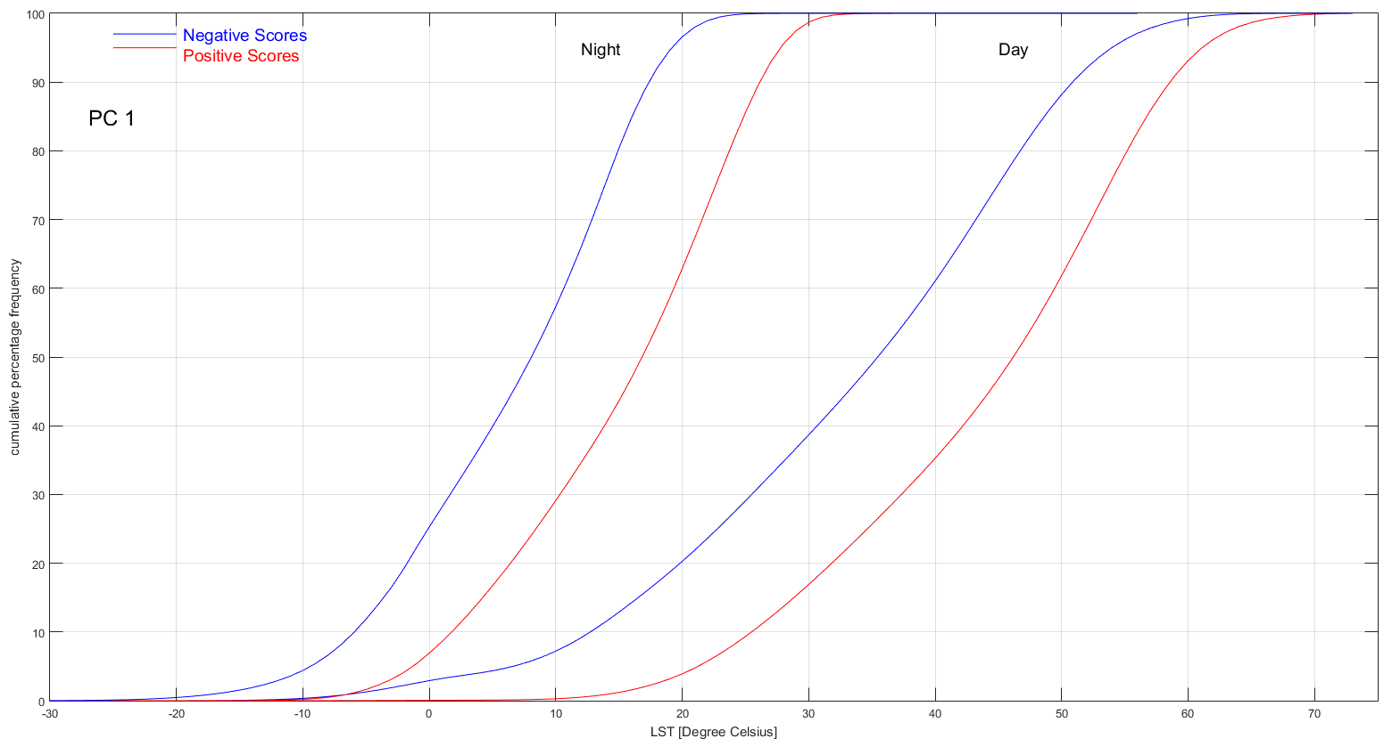
PC 1 LST Frequency Distribution

Slide 21
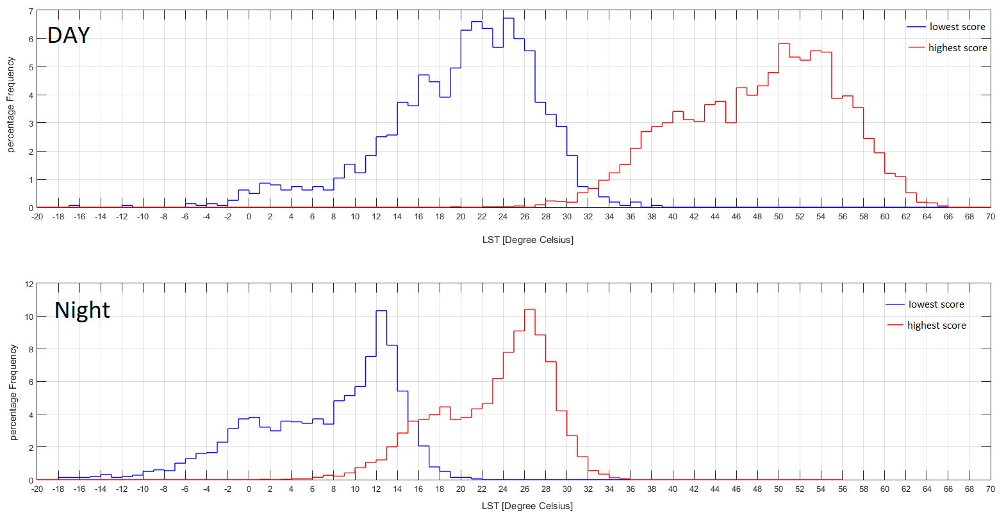
PC1 Highest Lowest Score

Slide 22
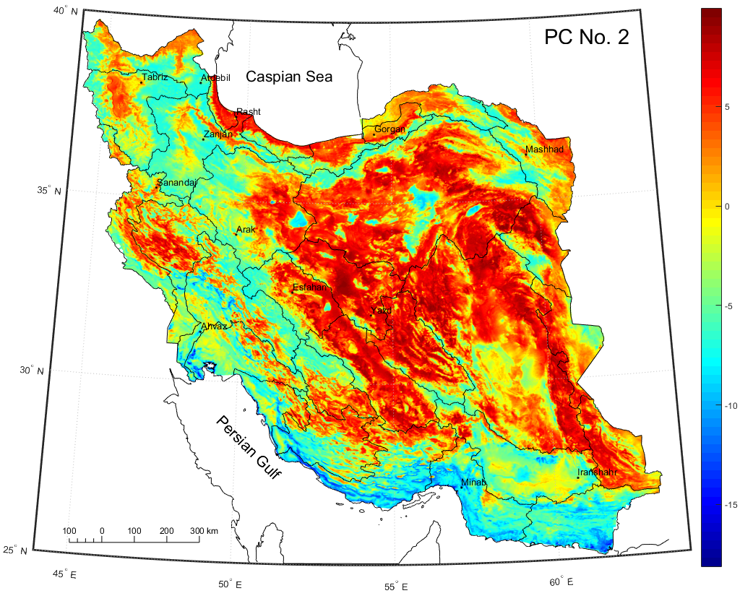
Diurnal Component

Slide 23
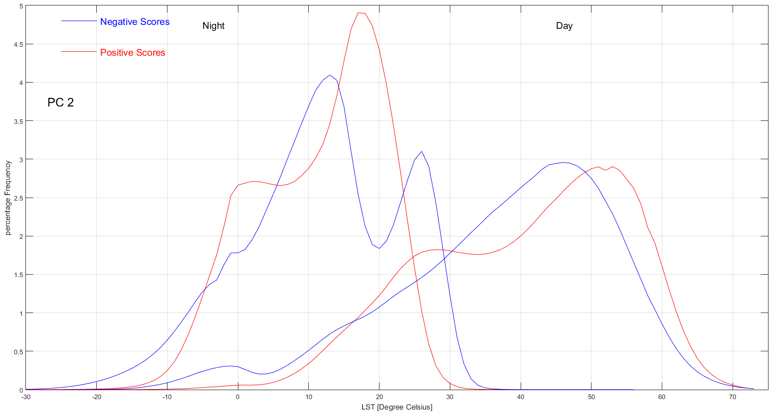
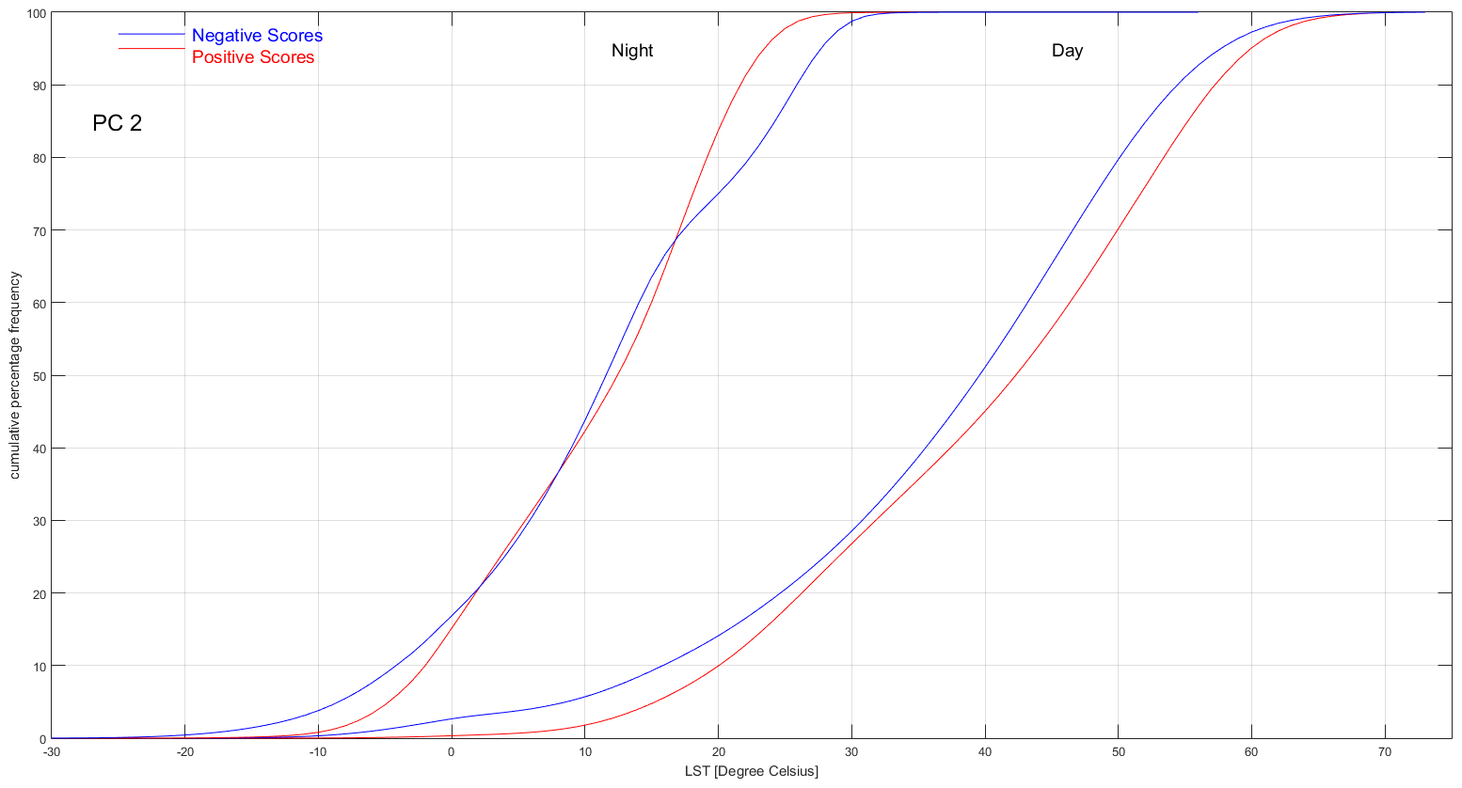
PC 2 LST Frequency Distribution

Slide 24
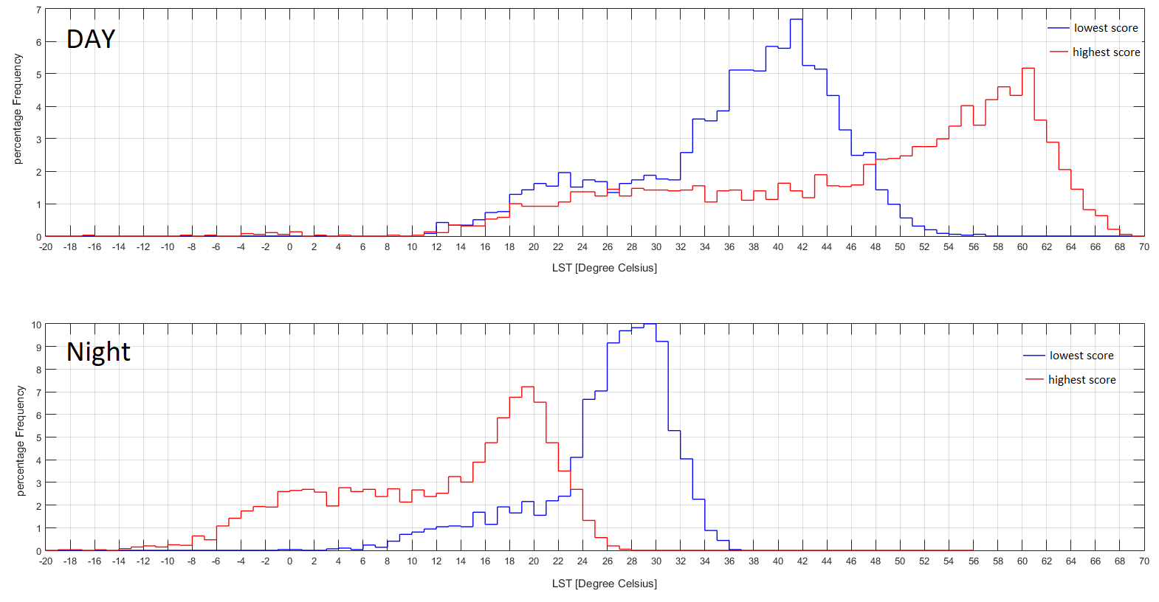
PC2 Highest Lowest Score

Slide 25
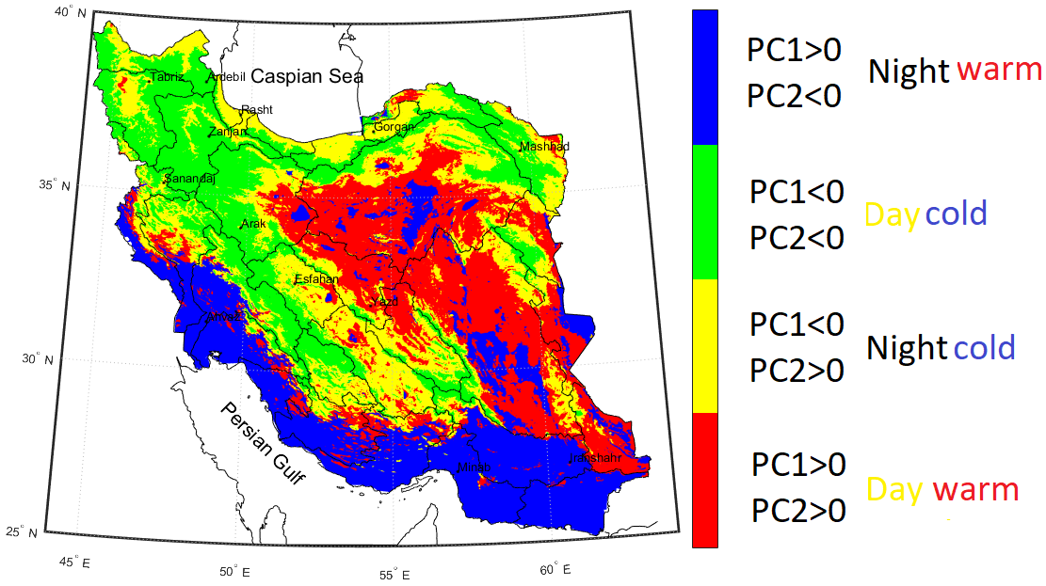
PC1 Vs PC2

Slide 26
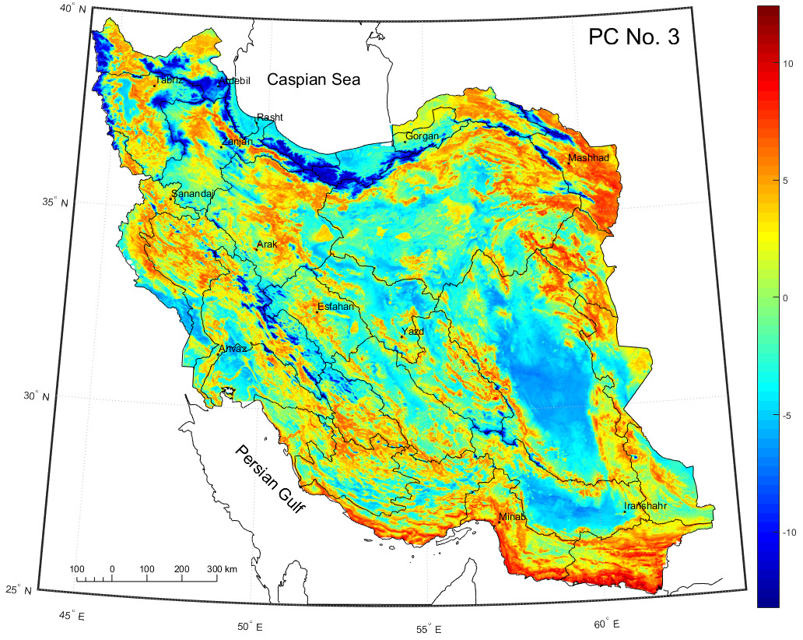
Snow Cap Component

Slide 27
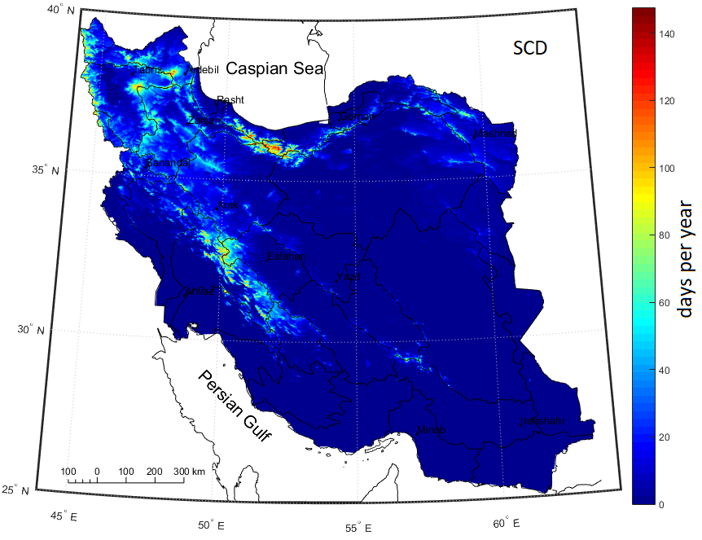
long term mean snow cover day (based on MODIS\Terra & MODIS\Aqua

Slide 28
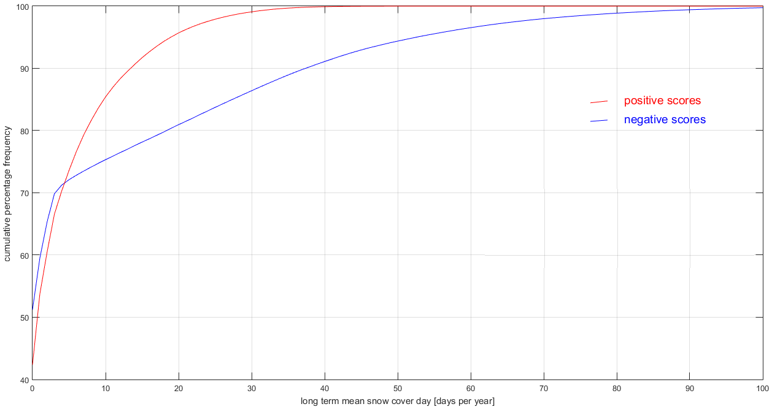

Slide 29
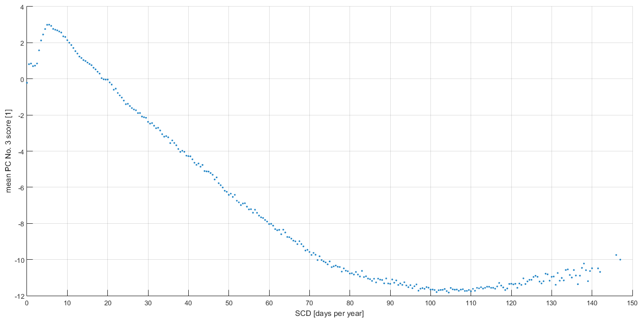
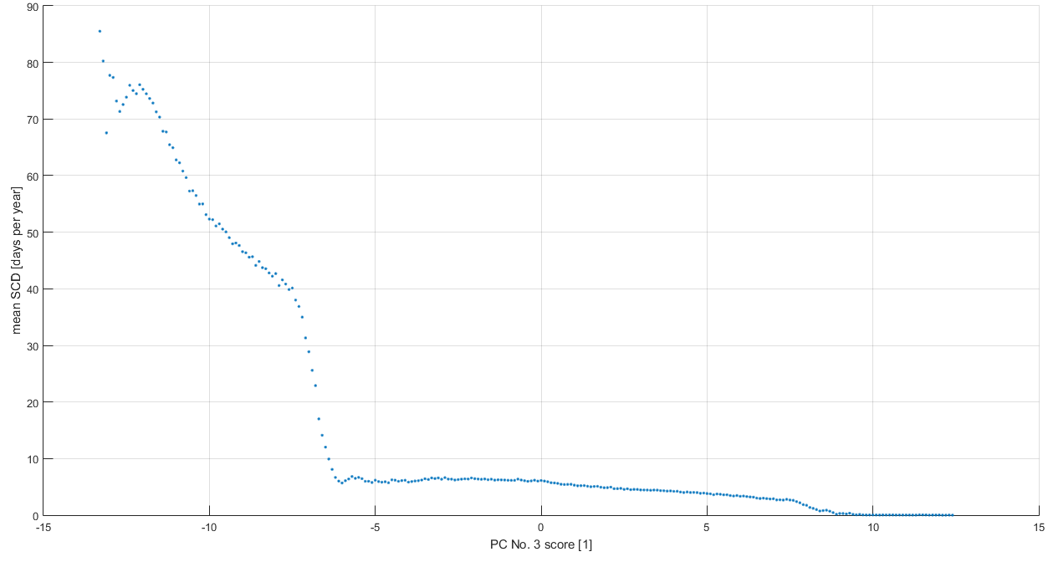

Slide 30
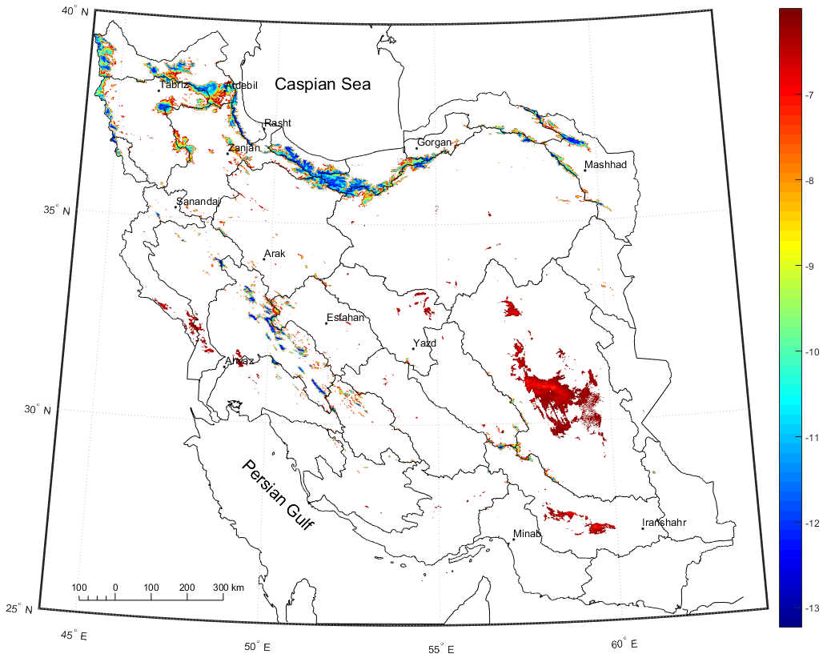
Similarity of reflectance from snow caps and sand dune areas

Slide 31
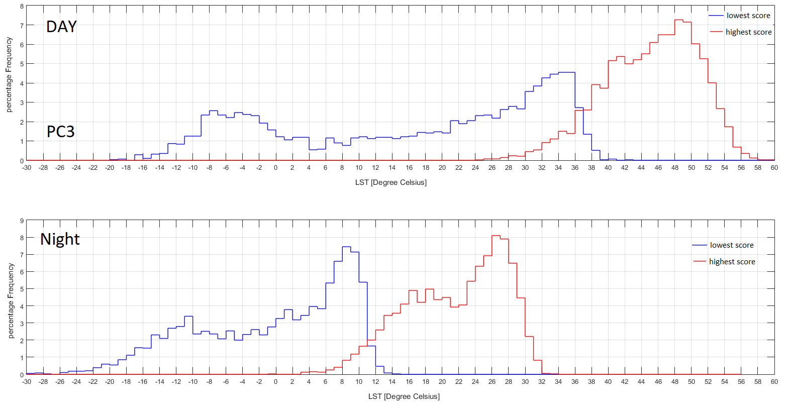
PC3 Highest Lowest Score

Slide 32
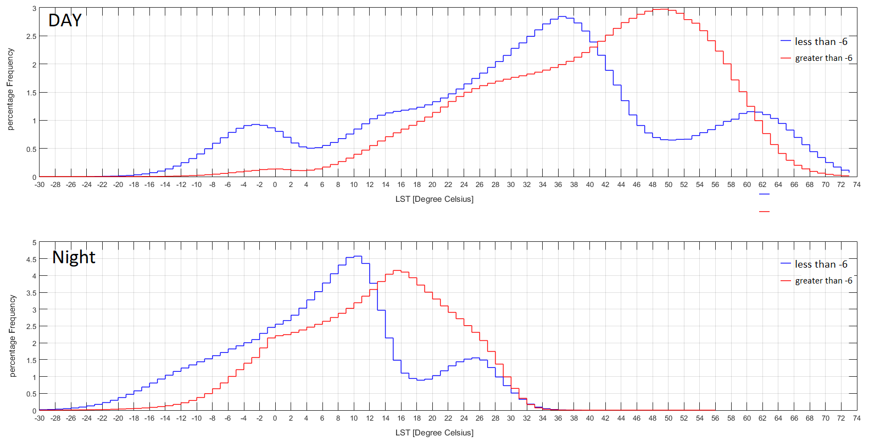
PC3 Scores lower/higher than -6

Slide 33
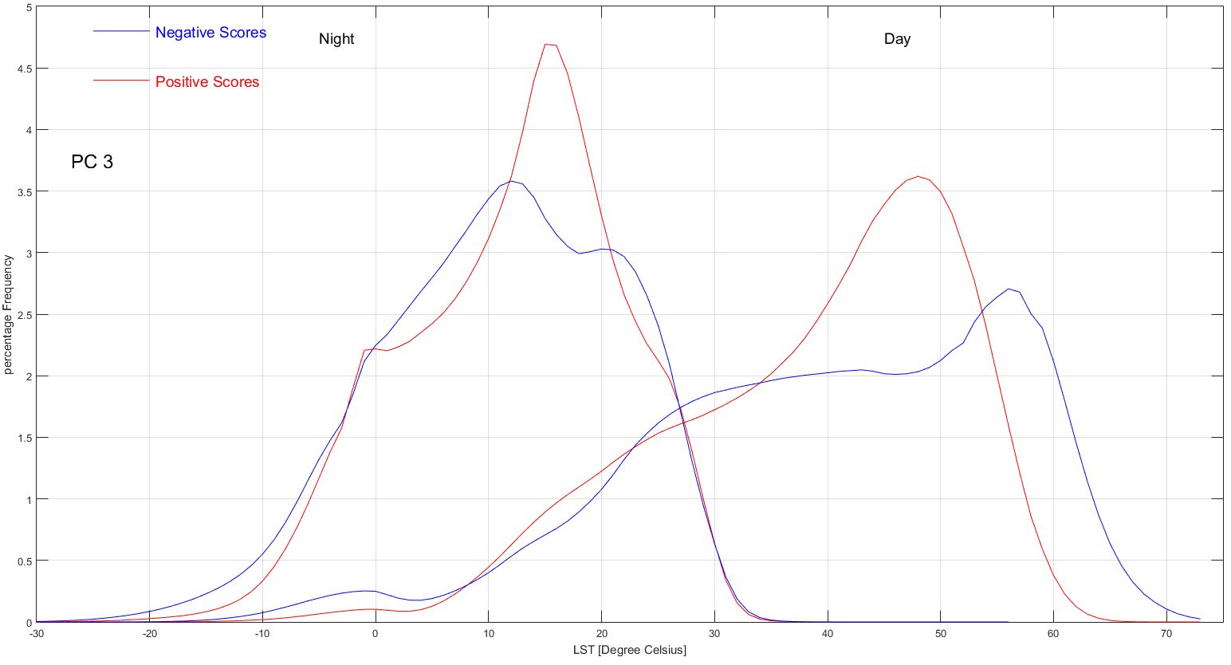
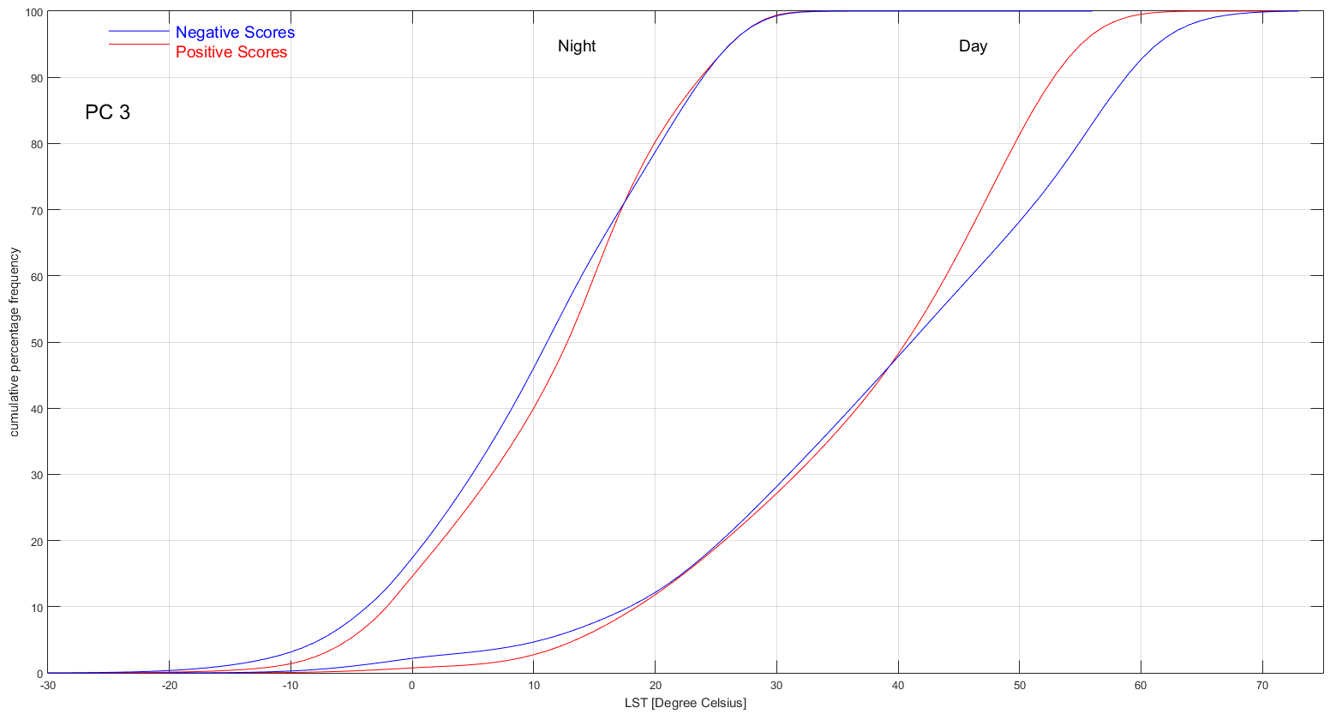
PC 3 LST Frequency Distribution

Slide 34
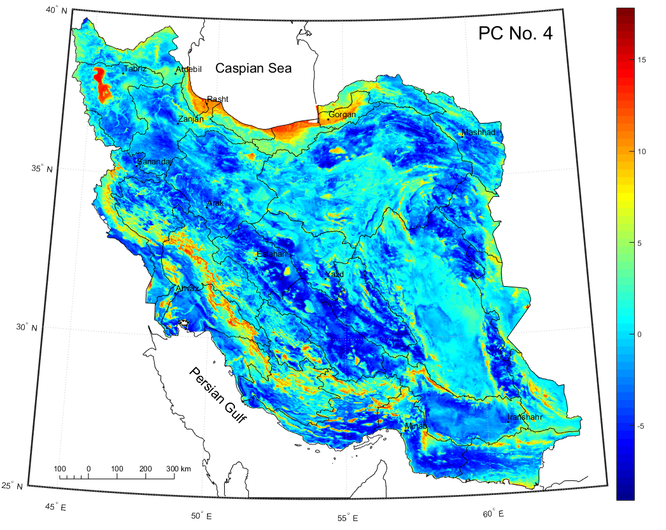
Moisture Component

Slide 35
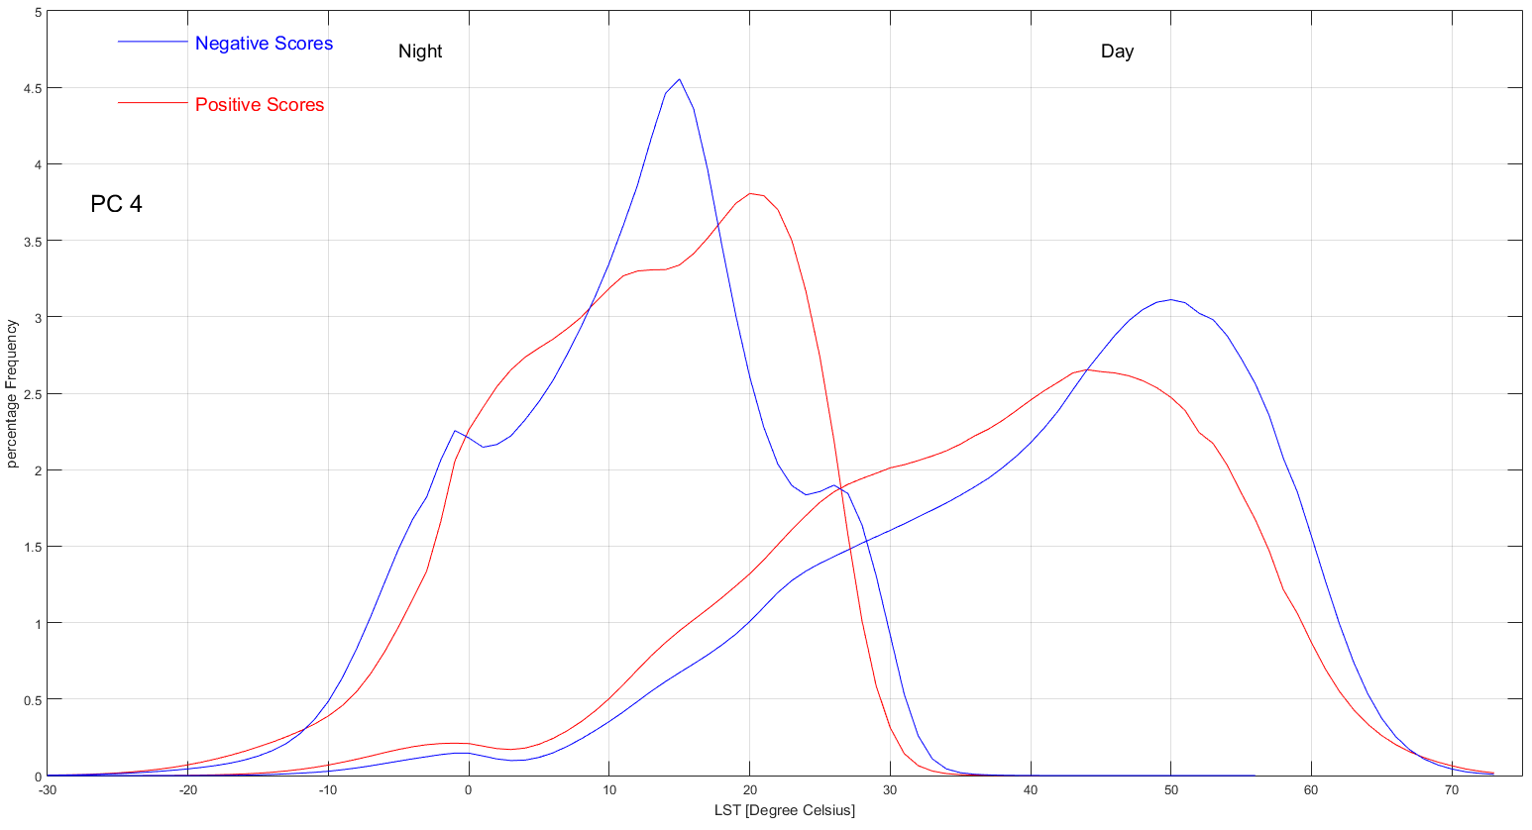
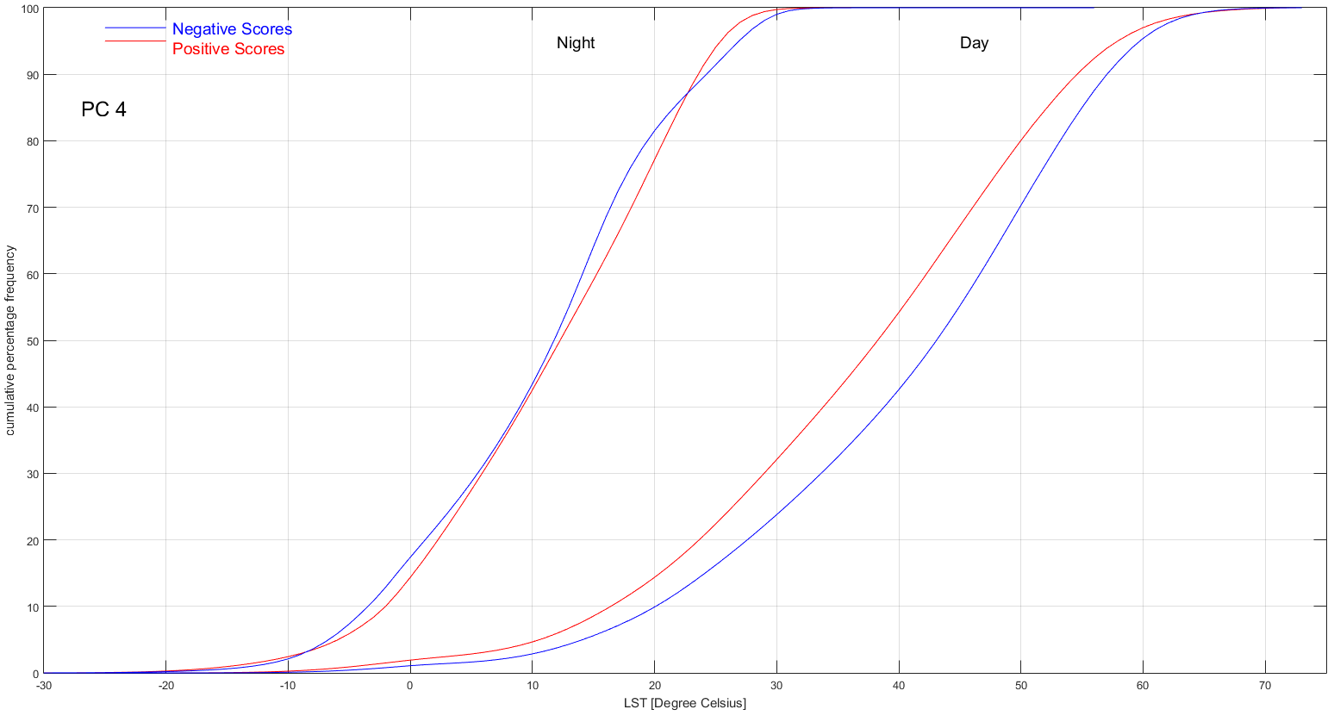
PC 4 LST Frequency Distribution

Slide 36
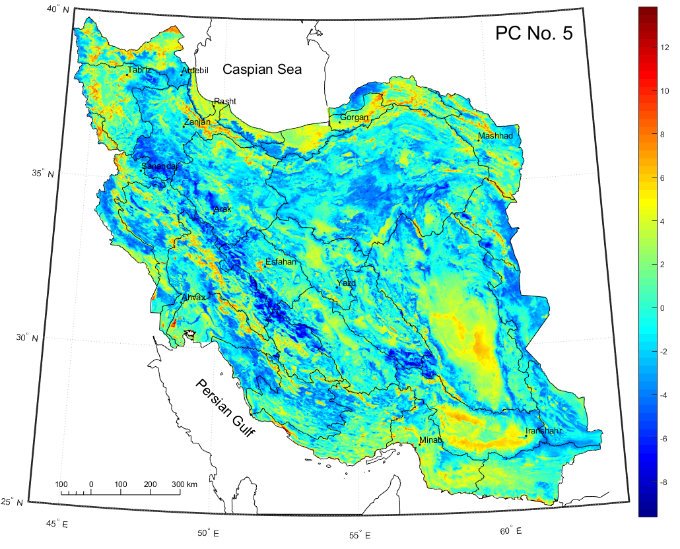
?? Component

Slide 37
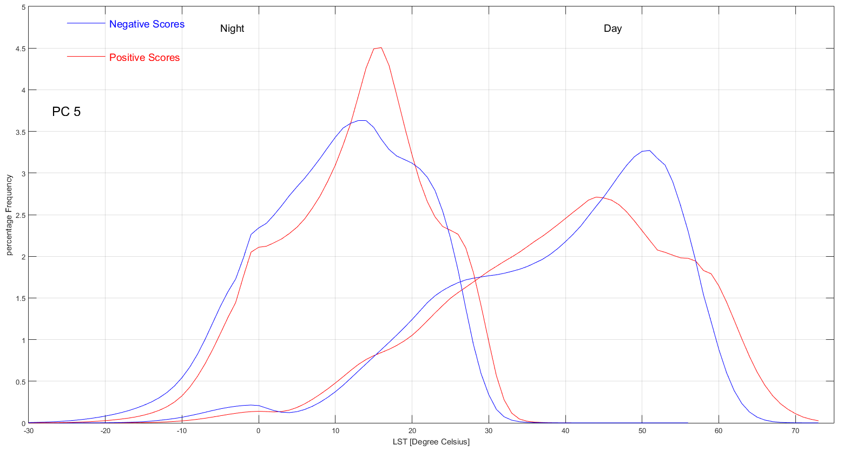
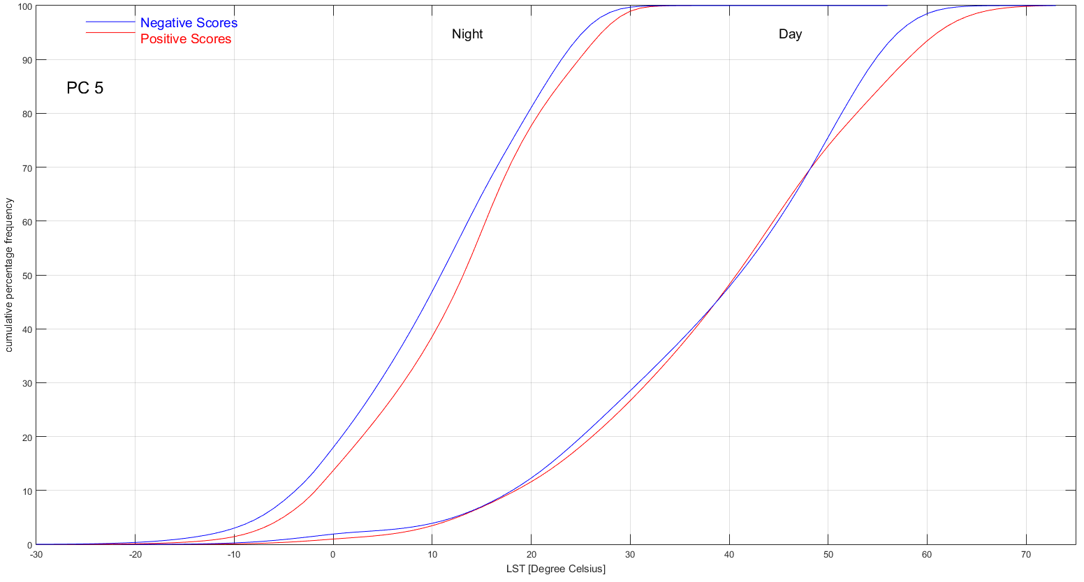
PC 5 LST Frequency Distribution

Slide 38
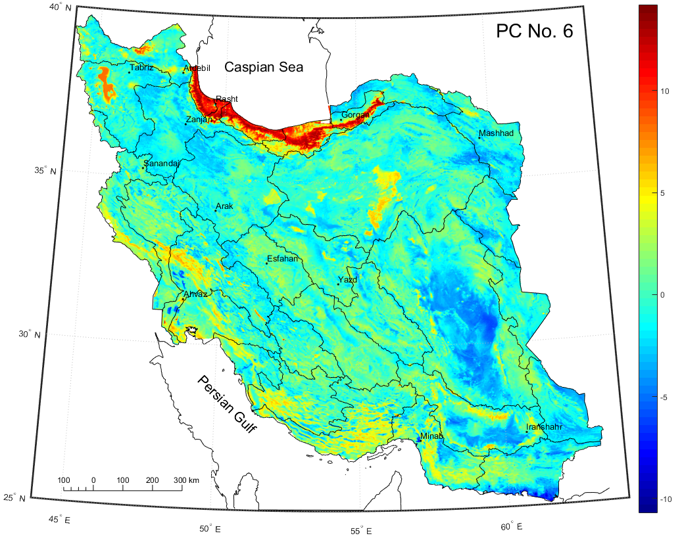
Plain Component

Slide 39
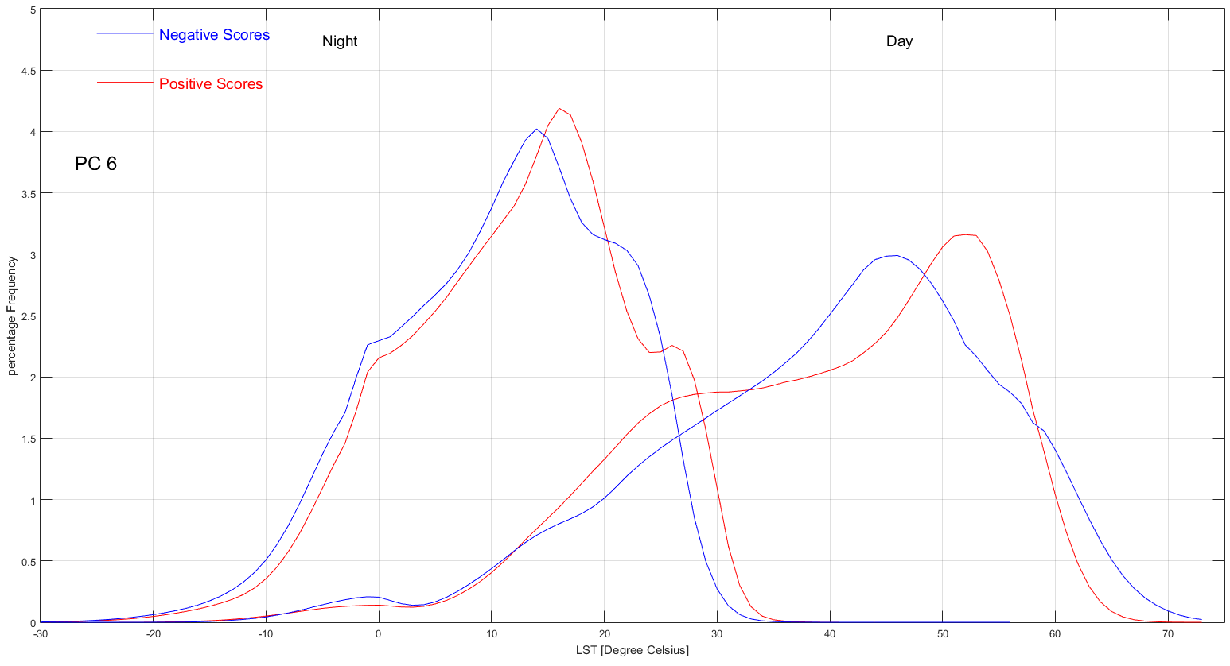

PC 6 LST Frequency Distribution

Slide 40
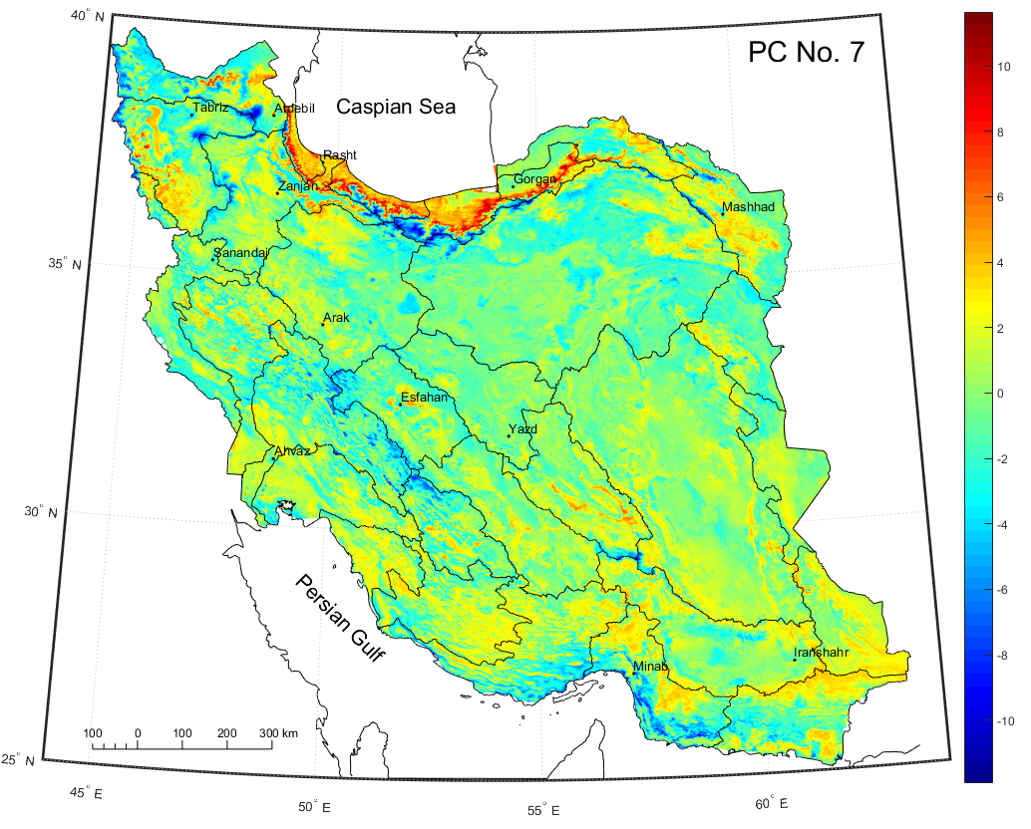
Mountain – Plain Component

Slide 41
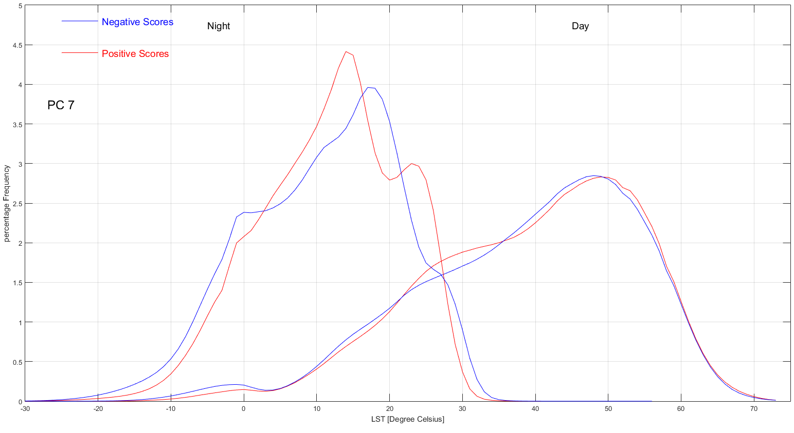
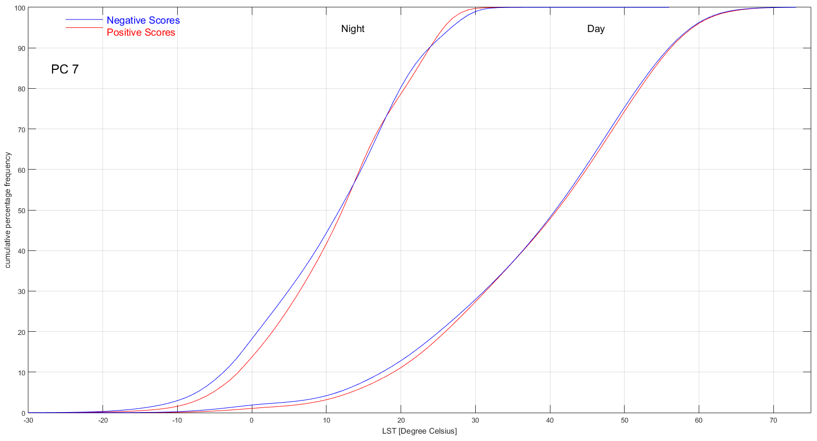
PC 7 LST Frequency Distribution

Slide 42
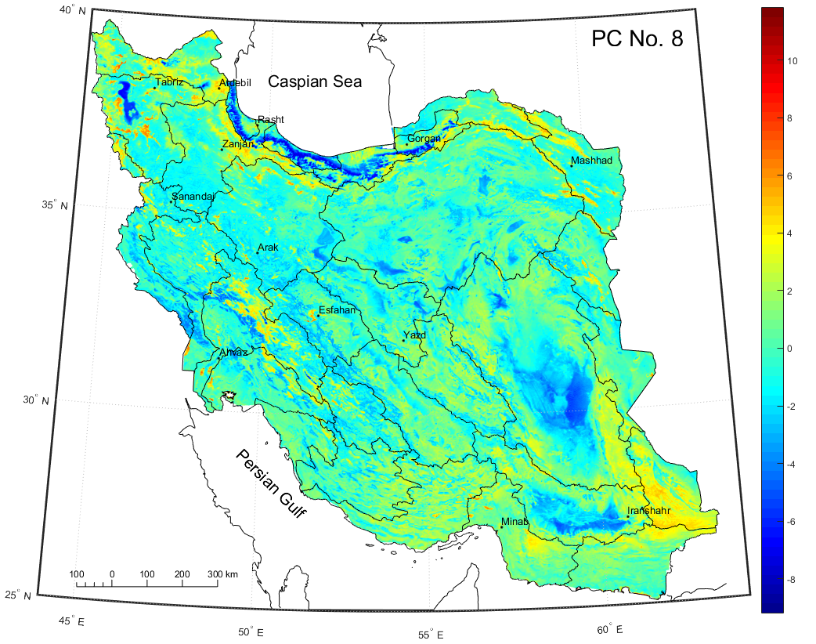
Sand Dune Component

Slide 43
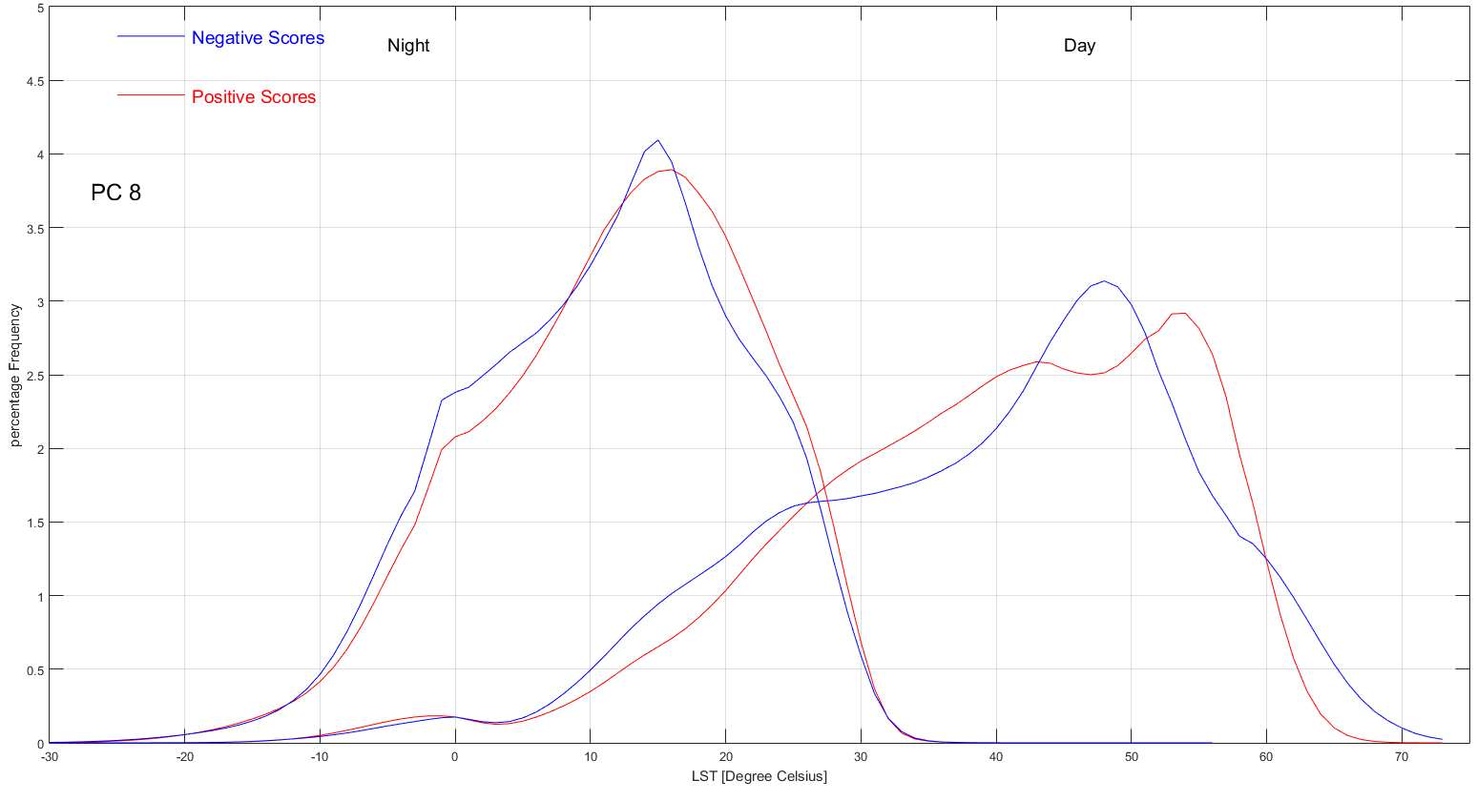
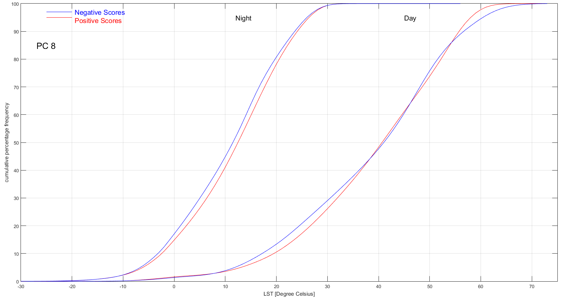
PC 8 LST Frequency Distribution

Slide 44
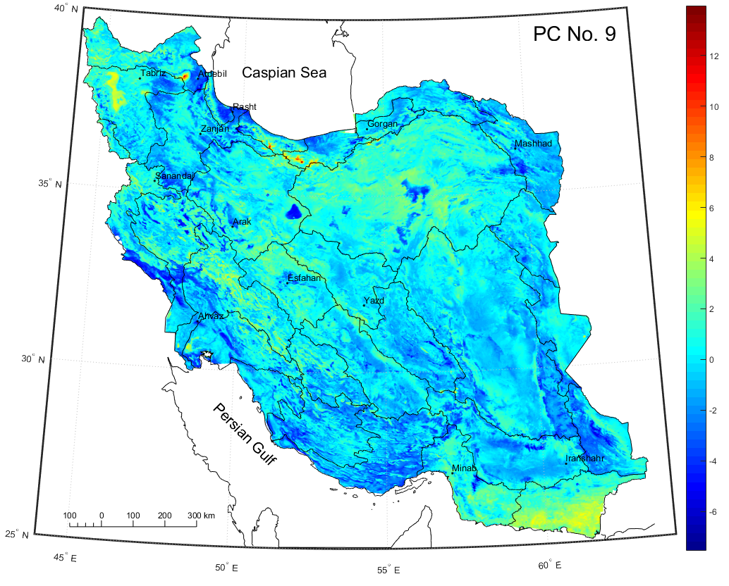
Salt Lake Component

Slide 45


PC 9 LST Frequency Distribution

Slide 46

Urmie Lake Component

Slide 47


PC 10 LST Frequency Distribution

