Slide 1
Detection of Frequency Signature of Geographical Land Features by using MODIS LST Data Part I Introduction
Seyed Abolfazl Masoodian
University of Isfahan
Isfahan, Iran

Slide 2
Part I : Introduction Definitions MODIS Data Products Retrieving Data Data Preparation Part II : Climatology of LST of Iran Regional Studies Local Studies Part III : Preprocessing Basic Matrices PCA Part IV : Frequency Signature Selected Land Features Playa Mountain Urban Sand dune

Slide 3
Definitions

Slide 4
Climatology: Descriptive climatology deals with the observed geographic or temporal distribution of meteorological observations over a specified period of time. Scientific climatology addresses the nature and controls of the earth's climate and the causes of climate variability and change on all timescales. The modern treatment of the nature and theory of climate, as opposed to a purely descriptive account, must deal with the dynamics of the entire atmosphere–ocean–land surface climate system, in terms of its internal interactions and its response to external factors, for example, incoming solar radiation. Applied climatology addresses the climate factors involved in a broad range of problems relating to the planning, design, operations, and other decision-making activities of climate sensitive sectors of modern society.

Slide 5
Frequency Signature: Frequency signature is the percentage frequency distribution of a given variable which is statistically attributable to a given land feature

Slide 6
Frequency in Time - time series of minimum temperature in Tabriz station

Slide 7
Frequency in Time - frequency distribution of minimum temperature in Tabriz station

Slide 8
Frequency in Space
Mean LST\Aqua Night
Frequency Distribution of LST\Aqua Night over Iran

Slide 9
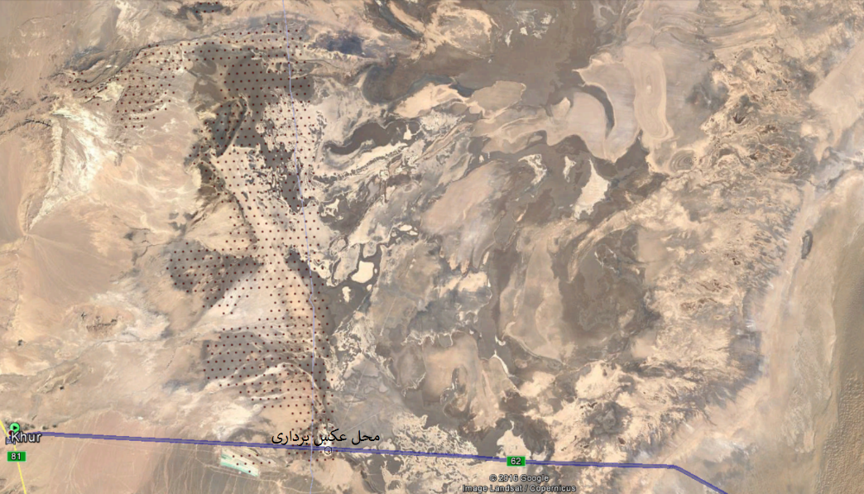
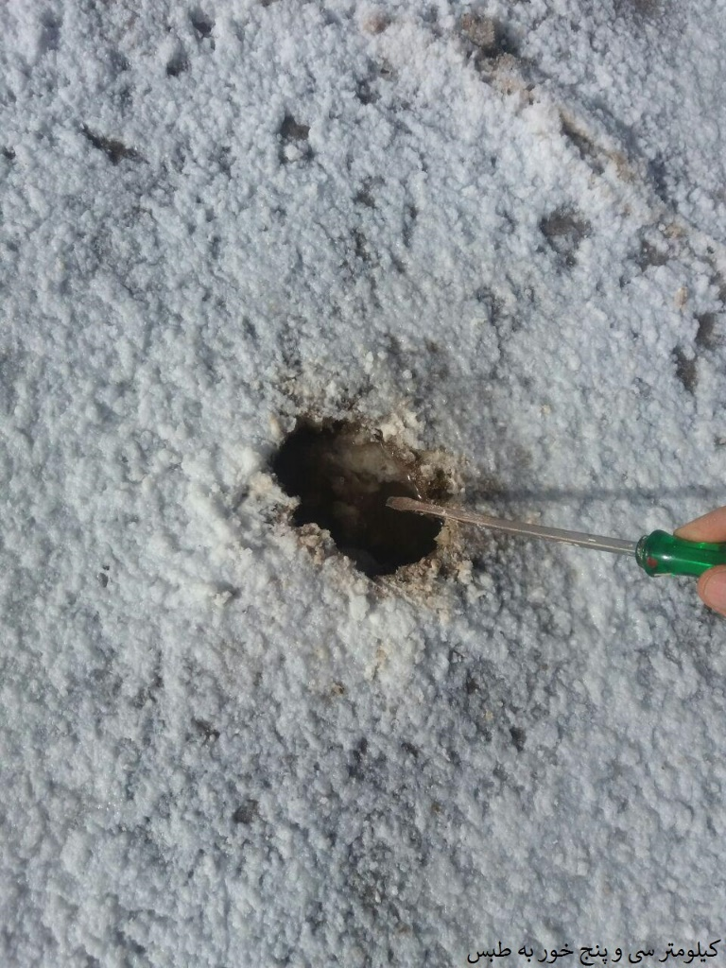
Frequency in Space
Mean LST\Aqua Night
Frequency Distribution of LST\Aqua Night over Iran

Slide 10
MODIS Data Products

Slide 12
Aqua/Terra Pass Time

Slide 13
Device Specifications

Slide 14
Atmospheric Window

Slide 15
Data Products

Slide 18
Retrieving Data:

Slide 19
Data gathering: https://search.earthdata.nasa.gov/search

Slide 20
Registering/Login

Slide 21
Registering:

Slide 22
Select Data Product:

Slide 23
Select Time Span:

Slide 24
Select Spatial Area:

Slide 25
Downloading Data:

Slide 26
Data Volume

Slide 27
Getting Data Links:

Slide 28
Copying Data Links:

Slide 29
Save Data Links:

Slide 30
Data Preparation

Slide 31
MODIS HDFs with sinusoidal projections Global Grid Description

Slide 32
Sample:

Slide 35
HDF Tool:

Slide 36
Scientific Data Set (SDS) Structure

Slide 37
Read a Tile:

Slide 38
Visualization:

Slide 39
Output:

Slide 40
Mosaic: lat & lon matrices

Slide 41
Mosaic: Data matrix

Slide 42
Visualization of mosaic:

Slide 43
Output:

